Slide 1

ANGELS ONLINE EVENTS GUIDELINE
Many Learnings of On-the-line Events to Make Benefit Glorious Initiative of Angels
28.5.2020 (v1.0)

Slide 2
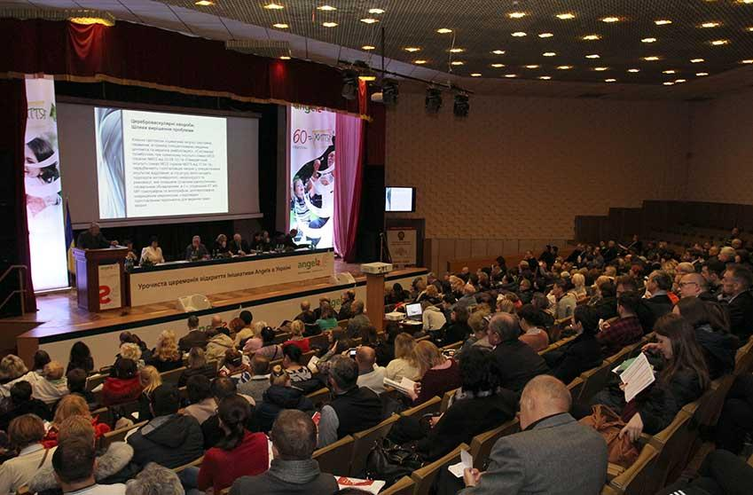
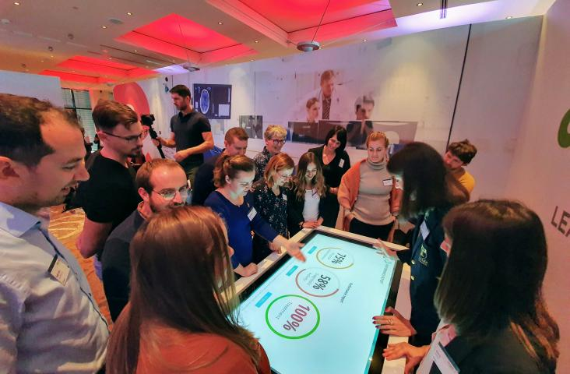
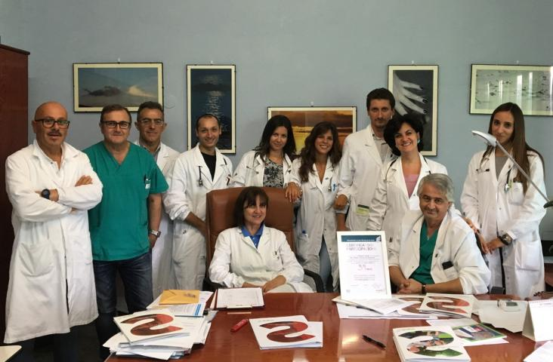
Classification of Angels Online Events
WEBINAR
WORKSHOP
CONSULTANCY

Slide 3
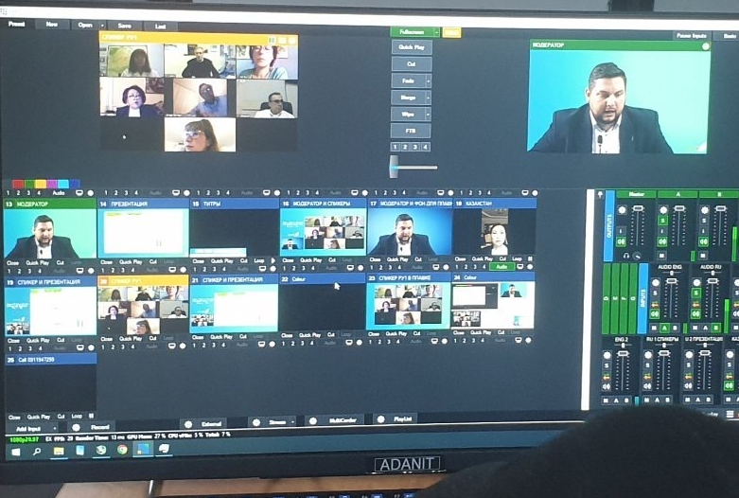
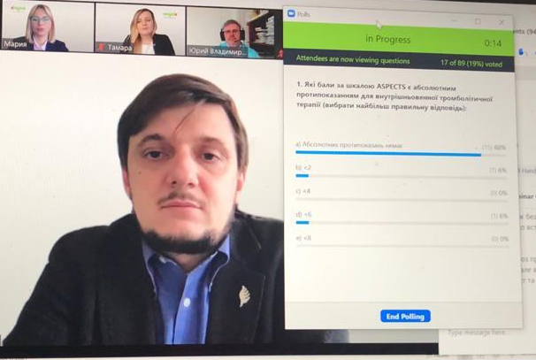
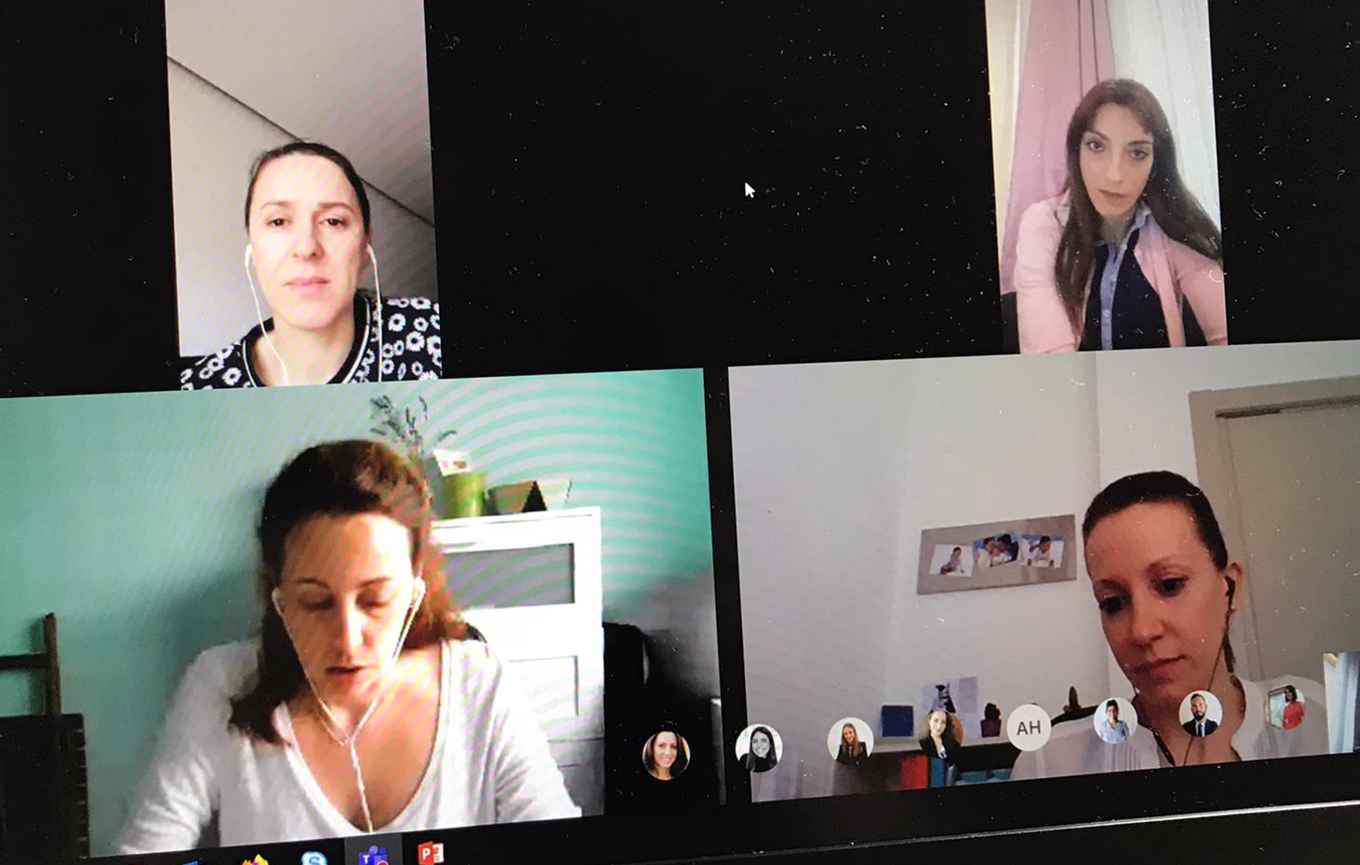
Classification of Angels Online Events
WEBINAR
WORKSHOP
CONSULTANCY
EQUIVALENT TO SEMINARS OR SYMPOSIUMS
EQUIVALENT TO ANGELS DAY, TTT, EMS
OR NURSE WORKSHOPS
EQUIVALENT TO HOSPITAL, COORDINATION OR COMMITTEE MEETINGS
GOAL: DISSEMINATE INFORMATION
GOAL: CHANGE IN BEHAVIOR & PRACTICE
GOAL: COORDINATE & MONITOR IMPLEMENTATIONS
TOPICAL THEME OR SUBJECT
(E.G. COVID-19, GUIDELINES, COUNTRY REPORT)
FRAMED WITHIN THE ANGELS 4 PRIORITY ACTIONS
VARIOUS TOPICS
ONE-WAY COMMUNICATION
INTERACTIVE COMMUNICATION
PERSONAL COMMUNICATION
MEDIUM TO LARGE AUDIENCE (50 – 1,000 pax)
SMALL TO MEDIUM AUDIENCE (3 – 100 pax.)
SMALL AUDIENCE (1 – 15 pax)

Slide 4





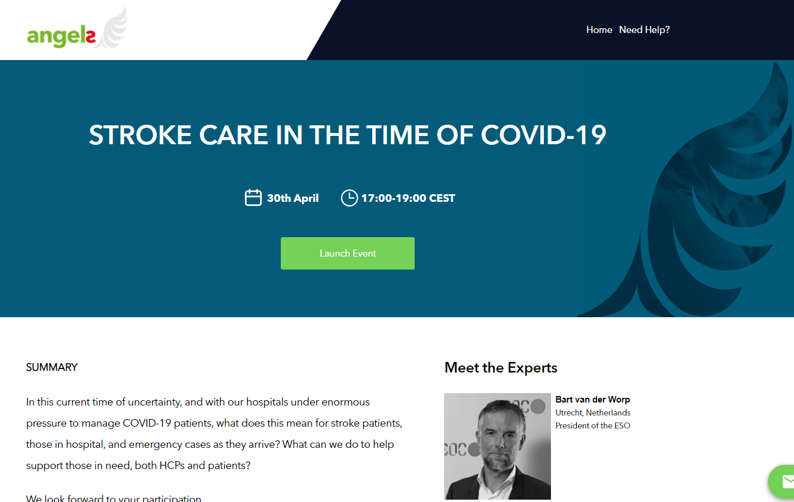
Connection Methods
BROADCAST WEBINAR
DIRECT WEBINAR
SPEAKERS
ONLINE MEETING
SPEAKERS
PARTICIPANTS
TECHNICIANS
PARTICIPANTS
PARTICIPANTS

Slide 5
Planning an Angels Webinar & Workshop
CONTENT COORDINATION
(Define your agenda incl. dates, programmes, speakers & moderators)
D-∞
SPEAKER MANAGEMENT
CONTRACTS & VIDEO CONSENT
CONTENT BRIEFING SESSION
SLIDES REVIEW & SUBMISSION
REMOTE PRESENTER BRIEFING GUIDE
LOGISTICS MANAGEMENT
AGENCY BRIEFING SESSION
INVITATION DESIGN & REVIEW
PLATFORM DESIGN & REVIEW
PLATFORM TESTING
D-21 to D-2
INTERACTIVITY
LIVE POLLING
VIRTUAL TRAINING TOOLS
Q&A / PANEL DISCUSSION
INVITATION & REGISTRATION
OPEN VS CLOSED ATTENDANCE
SENDGRID VS PERSONAL INVITE
OTHER DISSEMINATION CHANNELS
TECHNICAL MEETING
PLATFORM WALKTHROUGH
CONNECTION, AUDIO & VIDEO CHECK
MITIGATION PLANS
TECHNICAL REHEARSAL
D-2
LIVE EVENT
FINAL TECHNICAL CHECK (H-1)
HOUSEKEEPING NOTES
EVENT MANAGEMENT
TECHNICAL TROUBLESHOOTING
REGISTRATION
OPEN ATTENDANCE
Agencies must create any kind of form for viewers to indicate speciality
REGISTRATION
CLOSED ATTENDANCE
Keep invitation list and categorize the participant by speciality
D-0
FOLLOW-UP
THANK YOU EMAIL
DEBRIEFING SESSION
PARTICIPANT ENGAGEMENT
D+1 to D+7

Slide 6


Helsinki Ingelheim Measures
12 measures to optimize online event pathways
LESS IS MORE
THE MORE SPEAKERS, THE MORE TECHNICAL COMPLICATIONS. FOUR SPEAKERS IS A GOOD NUMBER FOR A 2-3 HOURS SESSION.
1
REGISTRATION & ATTENDANCE
THROUGH THE (PRE)REGISTRATION, ASK PARTICIPANT FOR AT LEAST THEIR NAME, EMAIL AND SPECIALITY AS AN ACCESS MECHANISM.
7
SPEAKER COORDINATION
ORGANIZE A MEETING WITH ALL SPEAKERS TO INTRODUCE EACH OTHER, DISCUSS CONTENT, EXPECTATIONS AND NEXT STEPS.
2
TECHNICAL MEETING
CONDUCT A THOROUGH TECHNICAL CHECK WITH ALL SPEAKERS FOLLOWED BY A SHORT REHEARSAL AT LEAST ONE DAY BEFORE.
8
QUESTION SEEDING
WHEN PLANNING A Q&A OR PANEL DISCUSSION SESSION, PREPARE UP TO 5 MOST LIKELY ASKED QUESTIONS IN ADVANCE.
3
BACKSTAGE COMMUNICATION
ENSURE THERE’S A SEPARATE COMMUNICATION CHANNEL BETWEEN MODERATOR, SPEAKERS, COORDINATOR AND TECHNICAL TEAM.
9
MITIGATION PLANNING
ESTABLISH AND TEST BACKUP SOLUTIONS, E.G. ALTERNATE CONNECTION FOR SPEAKERS, BACKUP STREAMING CHANNEL.
4
EVENT COORDINATOR
ASSIGN A FINAL DECISION MAKER FOR IF / WHEN A SITUATION CALLS FOR IT, E.G. SWAPPING AGENDA, PLAYING FILLER VIDEO, ETC.
10
FILLER CONTENT
PREPARE CONTENT FOR USE IN CASE OF TECHNICAL PROBLEM, E.G. ANGELS VIDEOS, „BE RIGHT BACK“ GRAPHICS, PHOTO OF SPEAKER.
5
SATISFACTION SURVEY
DON’T MISS THE OPPORTUNITY OF GETTING VALUABLE PARTICIPANT FEEDBACK TO IMPROVE YOUR NEXT EVENT.
11
INVITATION
SENDGRID IS GREAT FOR MASS EMAILING BUT PERSONAL APPROACH IS MORE EFFECTIVE. TAKE ADVANTAGE OF OUR NETWORK/PARTNERS.
6
FOLLOW UP
GREAT SUCCESS.
12

