Slide 1
Hyper-acute phase
Presenters Name
Date

Slide 2

Formula 1 video
https://www.youtube.com/watch?v=RRy_73ivcms

Slide 3

Hospital data
ADD YOUR OWN DATA HERE

Slide 4
Stroke patients pathway
ARRIVAL IN NEUROLOGICAL ER
STROKE PHYSICIAN
EMERGENCY NURSE
STRICT DOCUMENTATION
AND CONSTANT REVIEW
OF DOOR-TO-NEEDLE TIMES
MEDIAN DOOR-TO-NEEDLE TIME 25 MIN
VITAL SIGNS
MEDICAL HISTORY
SHORT NEUROLOGICAL EXAM (NIHSS)
“POINT OF CARE” BLOOD TESTS
(INR, GLUCOSE, HB, ELECTROLYTE PANEL)
COMPLETE BLOOD TESTS
(AVAILABLE DURING THROMBOLYSIS)
CT (LOCATED DIRECTLY AT ER)
IMMEDIATE READING OF CT
24/7 NEUROLOGICAL COVERAGE
START THROMBOLYSIS IN THE CT-SCANNER

Slide 5
Helsinki measures
12 measures to reduce treatment delays
EMS INVOLVEMENT: EDUCATION OF DISPATCHERS AND EMS PERSONNEL, STROKE HIGH-PRIORITY DISPATCH
1
CT RELOCATED TO ER: PATIENT TRANSFERS OF SEVERAL METERS, INCLUDING ELEVATORS, WERE NO LONGER NEEDED
7
2
HOSPITAL PRE-NOTIFICATION: EMS CONTACTS STROKE PHYSICIAN DIRECT VIA MOBILE PHONE
CT PRIORITY AND CT TRANSFER: CT EMPTIED PRIOR TO PATIENT ARRIVAL, AND PATIENT TRANSFERRED STRAIGHT ONTO CT TABLE, NOT ER BED
8
ALARM AND PREORDER OF TESTS: LABORATORY AND CT ORDERED AND ALARMED AT PRE-NOTIFICATION
3
RAPID NEUROLOGIC EVALUATION: PATIENT IS EXAMINED UPON ARRIVAL ON CT TABLE
9
4
NO DELAY CT INTERPRETATION: STROKE PHYSICIAN INTERPRETS THE CT, NOT WAITING FOR FORMAL RADIOLOGY REPORT
PRE-ACQUISITION OF HISTORY: STATEWIDE ELECTRONIC PATIENT RECORDS AND EYEWITNESS INTERVIEW BEFORE/DURING TRANSPORTATION
10
PREMIXING OF TPA: WITH HIGHLY SUSPECTED THROMBOLYSIS CANDIDATES, TPA PREMIXED PRIOR TO PATIENT ARRIVAL
5
POINT-OF-CARE INR: LABORATORY PERSONNEL DRAW BLOOD WHILE PATIENT ON CT TABLE, AND PERFORM INSTANT POC INR
11
6
DELIVERY OF TPA ON CT TABLE: BOLUS ADMINISTERED ON CT TABLE
REDUCED IMAGING: WHILE ALL PATIENTS HAVE A CT, ADVANCED IMAGING RESERVED FOR UNCLEAR CASES ONLY
12

Slide 6
Helsinki measures
12 steps to reduce treatment delays
400
Treatment >3 hours from symptom onset
120
350
Treatment 0-3 hours from symptom onset
105
Door-to-needle time
300
90
250
75
200
60
Number of patients
Door-to-needle time, minutes
150
45
100
30
50
15
0
1998
1999
2000
2001
2002
2003
2004
2005
2006
2007
2008
2009
2010
2011
0
Year
NUMBER OF ANNUALLY TREATED PATIENTS AND MEDIAN DOOR-TO-NEEDLE TIMES
ANNUAL PATIENTS, WITH THOSE TREATED BEYOND 3 HOURS IN RED (BARS, LEFT AXIS) AND MEDIAN DOOR-TO-NEEDLE TIME IN MINUTES WITH INTERQUARTILE RANGE (LINE, RIGHT AXIS). TOTAL N 1,686. THE PROJECTED NUMBER OF PATIENTS FOR 2011 IS BASED ON THE OBSERVED NUMBERS OF THE FIRST 6 MONTHS.

Slide 7
Hospital simulation video

Slide 8

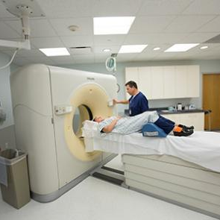
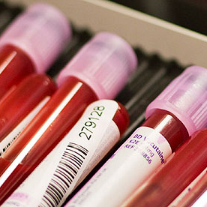
4 key actions to reduce DTN Time
1. AMBULANCE PRE-NOTIFICATION
2. DIRECT TO CT
3. TREAT AT CT
4. PRIORITY BLOODS

Slide 9
Pre-Notification

Slide 10

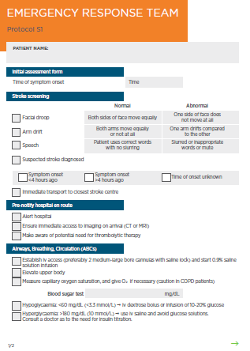
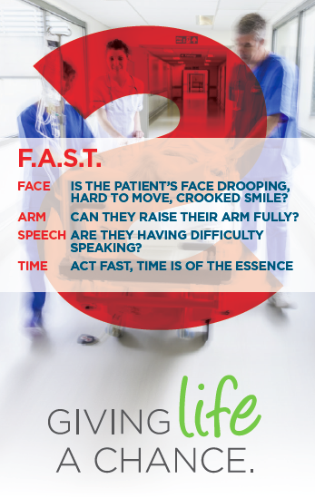
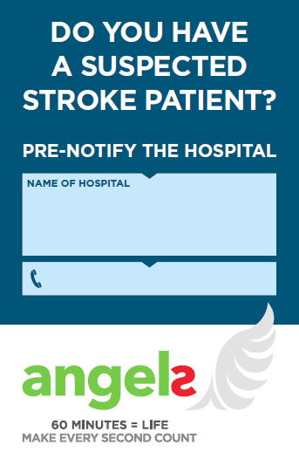
1. Pre-notification
IN YOUR FIRST SIMULATION
HOW MUCH TIME WAS LOST IN ARRANGING CT, LABS & GETTING THE STROKE TEAM TOGETHER?
DID THE PATIENT WAIT FOR THE DOCTOR OR THE OTHER WAY AROUND?
WHAT WAS THE DOOR TO FIRST MEDICAL CONTACT TIME?
IS PRE-NOTIFICATION DONE FOR STEMI?
BENEFITS
HOW?
ALERT STROKE TEAM
Notify Radiology to open CT for stroke patient
Notify Clinical lab to come and take bloods
Notify stroke specialist to meet patient at door at estimated arrival time
STROKE PHONE IN HOSPITAL
HOSPITAL BUSINESS CARD IN AMBULANCES
REDUCES IN-HOSPITAL DELAY
STROKE TEAM PRESENT ON PATIENT ARRIVAL AT THE DOOR
COLLECT RELEVANT INFO (EMERGENCY RESPONSE TEAM FORM)

Slide 11
Delivery Direct to CT

Slide 12

2. Direct to CT
IN YOUR FIRST SIMULATION
HOW MUCH TIME WAS SPENT IN THE EMERGENCY DEPARTMENT?
CAN TIME BE SAVED BY TRANSFERRING THE PATIENT DIRECTLY FROM THE AMBULANCE STRETCHER TO THE CT BED?
CONSIDER THE DISTANCE TO THE CT SCANNER
COULD TIME BE SAVED BY GOING DIRECT TO THE CT ROOM?
ARE STEMI PATIENTS TAKEN DIRECT TO THE ANGIO SUITE?
BENEFITS
HOW?
REDUCES IN-HOSPITAL DELAY
PREHOSPITAL STROKE PROTOCOL BYPASSES THE ED: PATIENT SHOULD BE MOVED FROM THE AMBULANCE STRETCHERS STRAIGHT ONTO CT TABLE, INSTEAD
OF AN ER BED
NO TIME LOST WITH TRANSFER FROM ER TO CT ROOM
DECREASE DOOR-TO-CT AND DOOR-TO-NEEDLE TIMES
INVOLVES AMBULANCE STAFF AS ADDITIONAL TEAM MEMBERS - BUY IN
CT ROOM SHOULD BE EMPTIED PRIOR TO PATIENT ARRIVAL
STROKE TEAM AND NEUROLOGIST MEET AT THE CT ROOM
RAPID NEUROLOGIC EVALUATION: PATIENT IS EXAMINED UPON ARRIVAL, ON CT TABLE
NO DELAY CT INTERPRETATION:
STROKE PHYSICIAN INTERPRETS THE CT, NOT WAITING FOR FORMAL RADIOLOGY REPORT
REDUCED IMAGING: CT ADVANCED IMAGING RESERVED FOR UNCLEAR CASES ONLY

Slide 13
Treat at CT

Slide 14
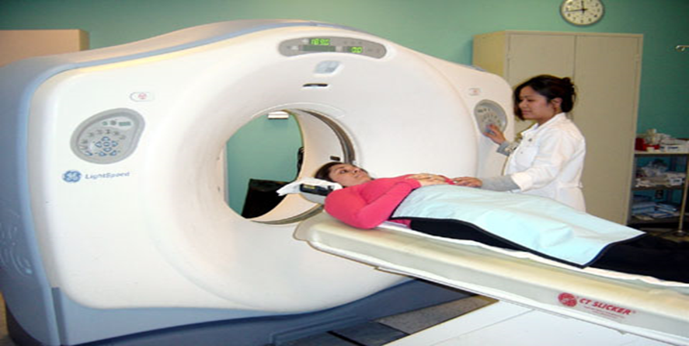
3. Treat at CT
IN YOUR FIRST SIMULATION
HOW MUCH TIME DID IT TAKE AFTER THE CT INTERPRETATION TO THERAPY START?
WAS CT INTERPRETED DIRECTLY AT THE SCANNER?
IF NOT HOW LONG DID IT TAKE TO GET REPORT?
TREATMENT DECISION PROTOCOL - WHAT ARE YOU CONSIDERING WHEN LOOKING AT THE CT IMAGE?
BENEFITS
HOW?
DECREASE DOOR-TO-NEEDLE TIME
DELIVERY OF RTPA ON CT TABLE: STROKE BAG
REDUCES IN-HOSPITAL DELAY
RTPA BOLUS ADMINISTERED ON CT TABLE FOLLOWED
BY INFUSION IN AN ADJACENT ROOM
NO TIME LOST WITH TRANSFER FROM CT ROOM TO ER
THE STROKE BAG CONTAINS ALL THE MATERIALS
AND DRUGS NEEDED TO START TREATMENT
THE STROKE BAG ALSO CONTAINS ALL CHECKLISTS
AND PROTOCOLS

Slide 15
ENABLES STROKE TEAMS TO TREAT THE PATIENT AT THE CT
REMOVE VARIABILITY:
ALL IN ONE PLACE (CHECKLISTS AND DRUGS/MATERIALS) AND GATHERS ALL THE RELEVANT INFORMATION (REQUIRED FORMS, CHECKLISTS AND REFERENCE DOCUMENTS)
THE STROKE BAG SHOULD BE RESTOCKED AFTER EACH PATIENT TREATMENT AND SHOULD BE STORED AT AN ACCESSIBLE PLACE
Stroke bag

Slide 16
Therapeutic Decision Making Process
Four steps to making therapeutic decision in Hyper Acute Stroke
DIAGNOSIS
EXCLUDE BLEEDING
ASSESS SEVERITY
IDENTIFY CONTRAINDICATIONS
*The ESO guidelines recommend the use of intravenous rt-PA for the thrombolysis of acute ischaemic stroke in eligible patients within 4.5 hours of the onset of stroke symptoms. (Class 1, Level A). Please check your local regulations and prescribing information.
European Stroke Organisation (ESO). Cerebrovasc Dis 2008;25(5):457-507. Update 2009.

Slide 17
Priority Bloods

Slide 18
Phases of acute stroke treatment
TREATMENT OF ACUTE STROKE PATIENTS CAN BE DIVIDED INTO THREE PHASES
HYPER ACUTE TREATMENT
AIMED AT STABILIZING THE PATIENT AND/OR REMOVING THE BLOOD CLOT TO PREVENT DEATH AND DISABILITY CAUSED BY THE ACUTE STROKE
ACUTE TREATMENT
AIMED AT PREVENTING OTHER CAUSES OF DEATH IN THE FIRST 24 HOURS
POST-ACUTE TREATMENT
AIMED AT PREVENTING RECURRENT STROKE
AS WELL AS OTHER CAUSES OF DEATH AND
DISABILITY FROM 24 HOURS ONWARDS

Slide 19
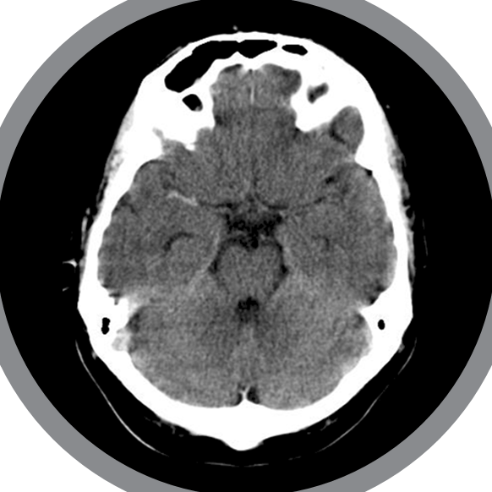
Phase 1: Hyper acute treatment
THE PRIORITY IN THIS PHASE IS TO SALVAGE THE REMAINING PENUMBRA BY RECANALYZING THE BLOCKED ARTERY IN ISCHEMIC STROKE OR TO REDUCE THE PRESSURE IN HEMORRHAGIC STROKE
THE ONLY LABORATORY RESULTS REQUIRED IN ALL PATIENTS BEFORE FIBRINOLYTIC THERAPY IS INITIATED IS A GLUCOSE DETERMINATION AND INR; USE OF FINGER-STICK MEASUREMENT DEVICES IS ACCEPTABLE
Acad Emerg Med. 1997 Oct;4(10):986-90.
European Stroke Organization guidelines 2008. Cerebrovasc Dis 2008;25(5):457-507.
AHA/ASA Guideline. Stroke.2013;44:870-947

Slide 20
Phase 2: Acute treatment
TO PREVENT THESE EVENTS PATIENTS HAVE TO BE MONITORED AND SPECIFIC LAB AND OTHER TESTS DONE IN THE FIRST 24 HOURS AFTER HYPER ACUTE TREATMENT.
Causes of death in stroke patients
CAUSE OF DEATH AFTER FIRST CI. DURING 10 YEARS OF FOLLOW-UP, 310 DEATHS OCCURRED AMONG 444 CI PATIENTS.
IDENTIFIED CAUSES OF DEATH ARE SHOWN IN ORDER OF FREQUENCY. “CARDIAC” DEATH INCLUDES FATAL MYOCARDIAL INFARCTION, FATAL ARRHYTHMIA, AND CONGESTIVE HEART FAILURE. COPD INDICATES CHRONIC OBSTRUCTIVE PULMONARY DISEASE; SUD, SUDDEN UNEXPECTED;
GI BLEEDING, FATAL GASTROINTESTINAL TRACT BLEEDING; PE, FATAL PULMONARY EMBOLISM.
Stroke. 2003;34:1828-1832

Slide 21
Bloods - after hyper acute treatment
LAB TESTS:
COMPLETE BLOOD COUNT (WITH PLATELET COUNT)
ELECTROLYTES PANEL (RENAL FUNCTION STUDIES)
CARDIAC MARKERS: TP
COAGULATION TESTS: PROTHROMBIN TIME (PT), ACTIVATED PARTIAL THROMBOPLASTIN TIME (APTT),
THROMBIN TIME (TT) OR ECARIN CLOTTING TIME (ECT)
DETERMINATION OF THE PLATELET COUNT AND, IN PATIENTS TAKING WARFARIN OR WITH LIVER DYSFUNCTION, THE PT/INR IS IMPORTANT.
CARDIAC MARKERS ARE FREQUENTLY ELEVATED IN ACUTE ISCHEMIC STROKE, WITH ELEVATIONS OCCURRING IN 5% TO 34% OF PATIENTS,
AND THESE ELEVATIONS HAVE PROGNOSTIC SIGNIFICANCE. ELEVATION OF CARDIAC TROPONIN T IS ASSOCIATED WITH INCREASED
STROKE SEVERITY AND MORTALITY RISK, AS WELL AS WORSE CLINICAL OUTCOMES.
IN PATIENTS USING DIRECT THROMBIN INHIBITORS, SUCH AS DABIGATRAN, AND DIRECT FACTOR XA INHIBITORS,
SUCH AS RIVAROXABAN AND APIXABAN, SPECIFIC COAGULATION TEST SHOULD BE USED:
THROMBIN TIME: SENSITIVE INDICATOR TO THE PRESENCE OF DABIGATRAN ACTIVITY, A NORMAL TT EXCLUDES THE PRESENCE
OF SIGNIFICANT ACTIVITY; HOWEVER, IT MAY BE INFLUENCED BY THE USE OF OTHER ANTICOAGULANTS.
ECARIN CLOTTING TIME: LINEAR RELATIONSHIP WITH DIRECT THROMBIN INHIBITOR LEVELS, A NORMAL ECT GENERALLY EXCLUDES A SIGNIFICANT DIRECT THROMBIN INHIBITOR EFFECT AND IS NOT INFLUENCED BY OTHER ANTICOAGULANTS.
Jauch EC, Saver JL, Adams HP, Jr., et al. Guidelines for the early management of patients with acute ischemic stroke: a guideline for healthcare professionals from the American Heart Association/ American Stroke Association. Stroke. 2013;44:870-947.

Slide 22
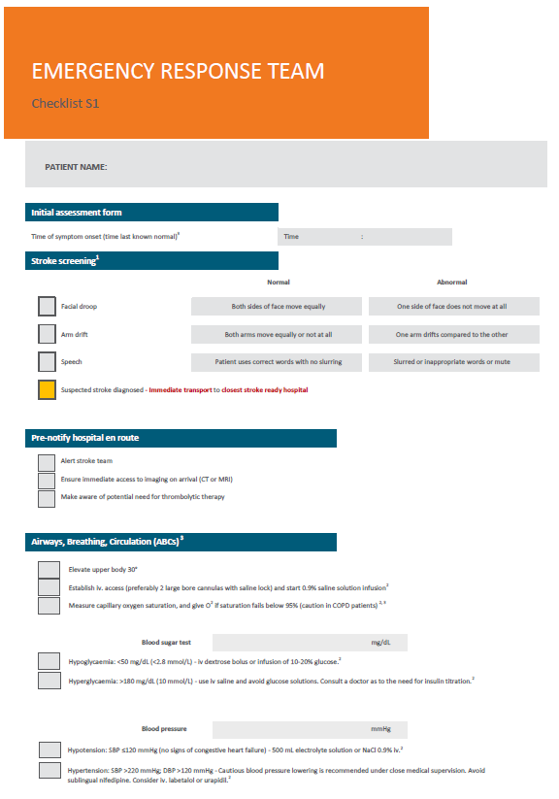
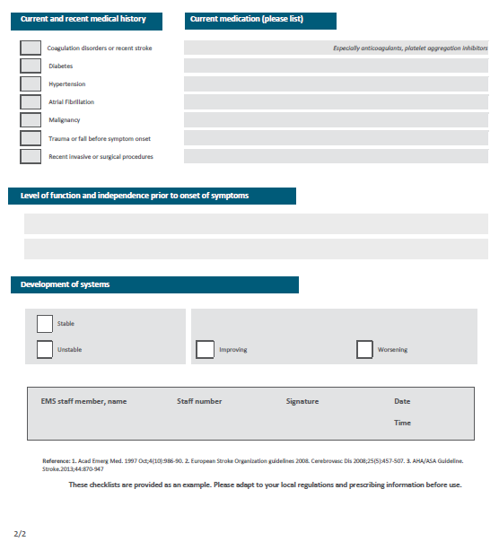

Slide 23
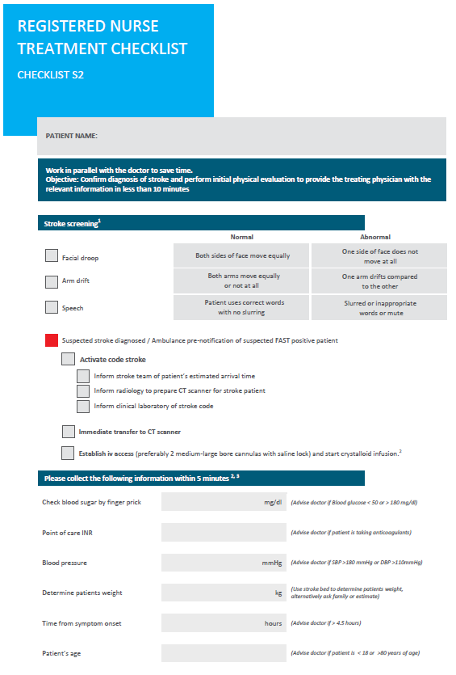
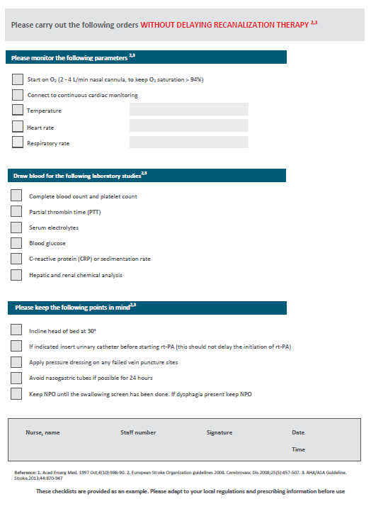
BEFORE HYPER ACUTE THERAPY
AFTER
HYPER ACUTE THERAPY

Slide 24
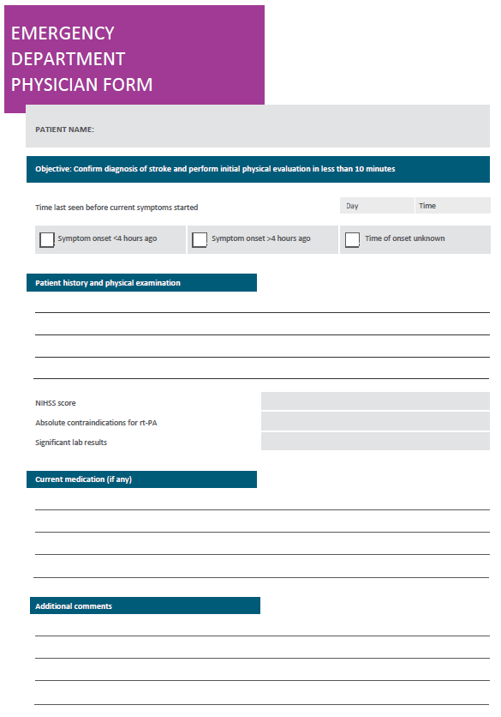

Slide 25
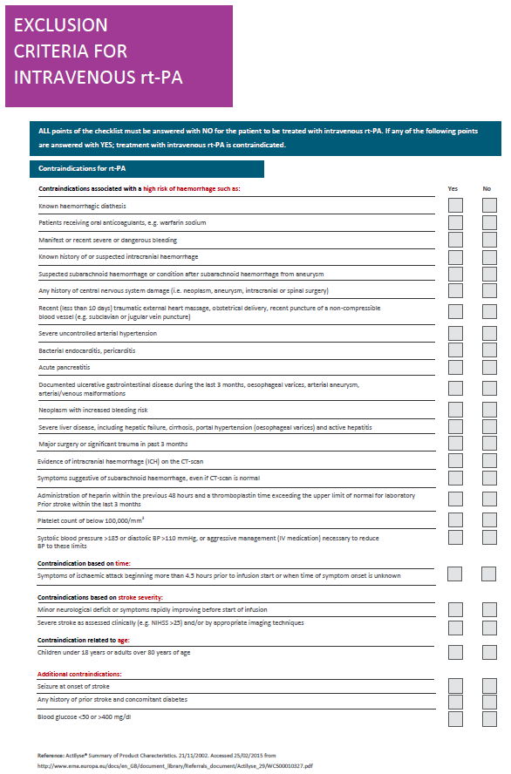
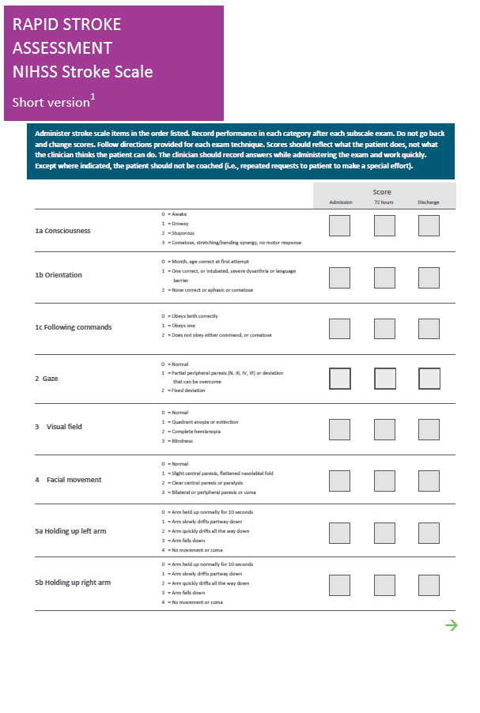

Slide 26
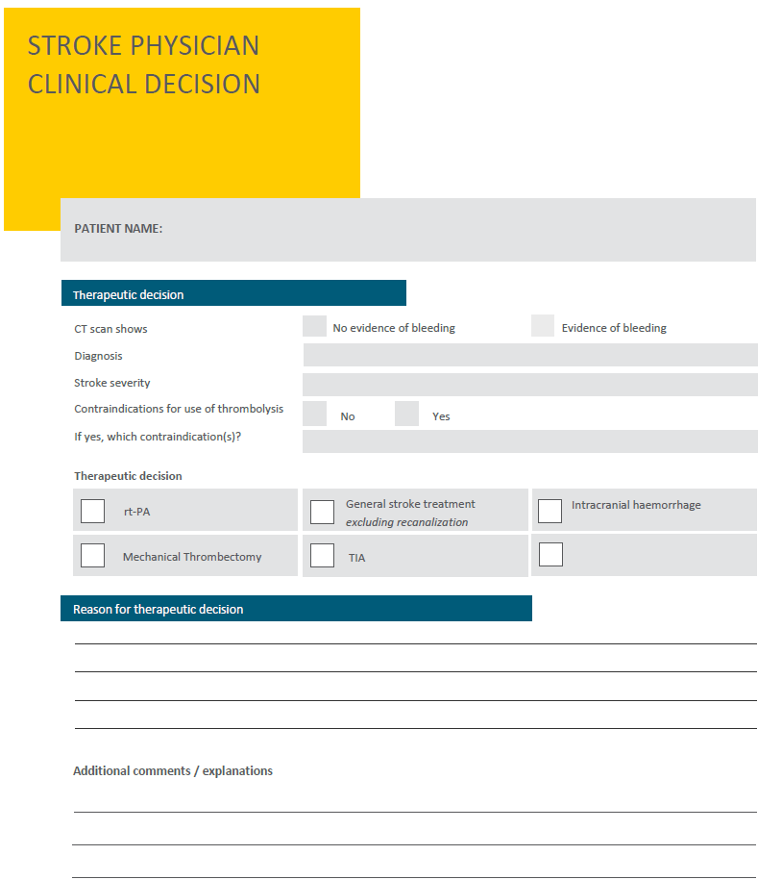

Slide 27
Dummy patient simulation video - Long DTN

Slide 28
Dummy patient simulation video - Short DTN

Slide 29
Slovak team in action –
In-hospital simulation

Slide 30
5 Minutes
Door to Therapy

Slide 31
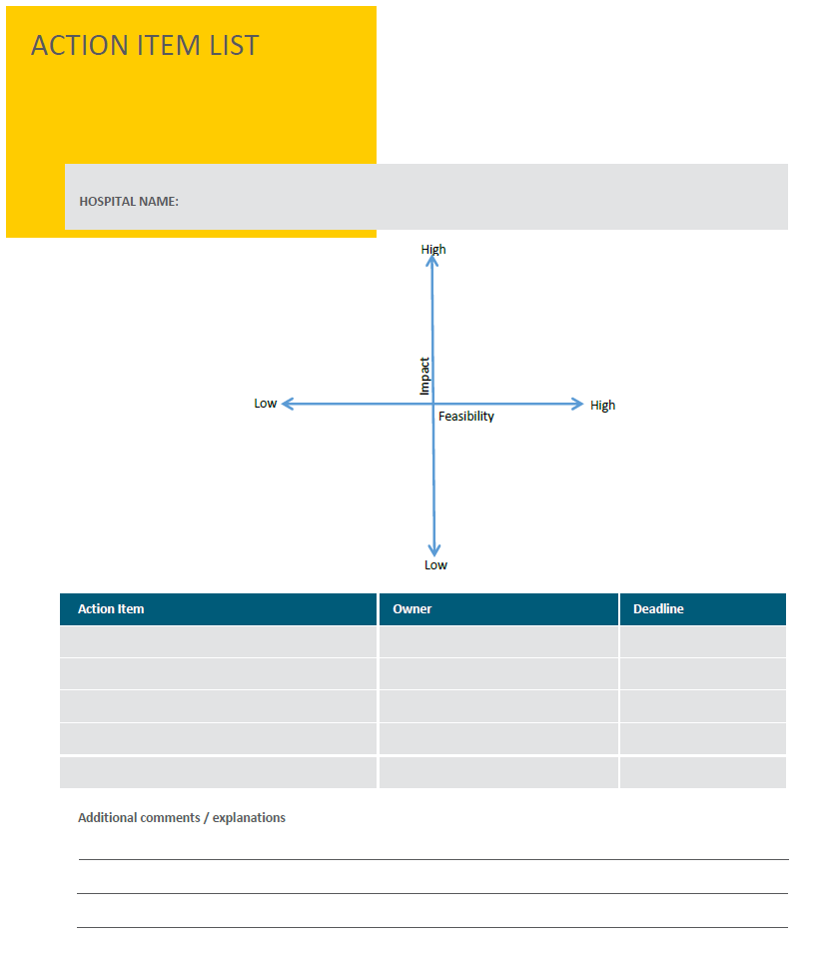

Slide 32
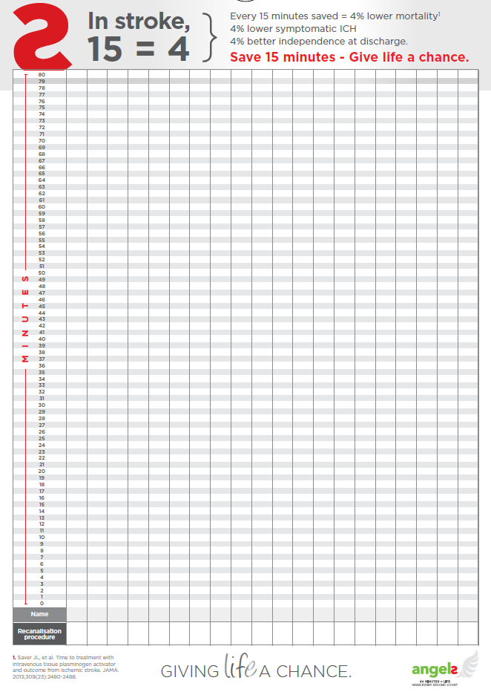
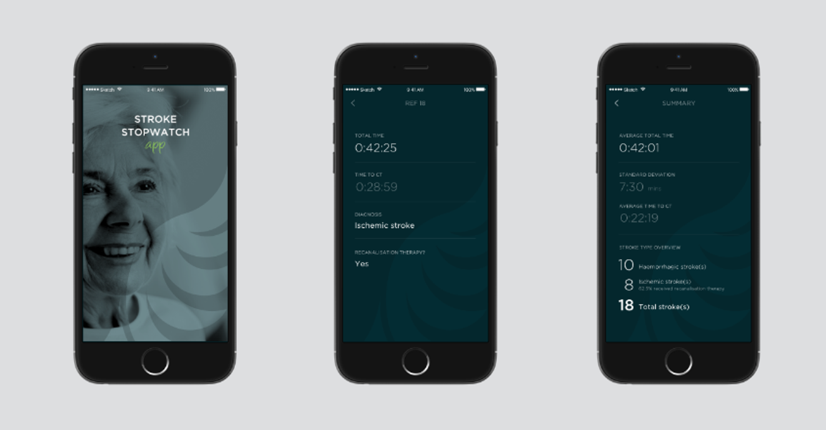
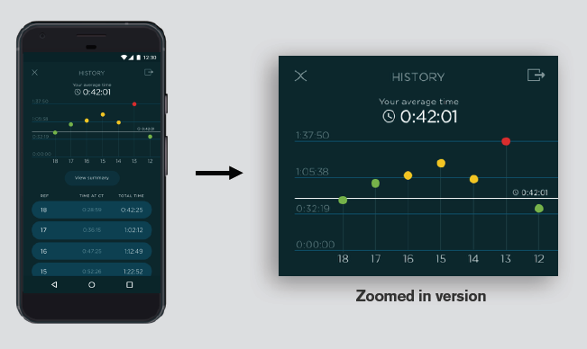
Progress monitoring

