Slide 1
Stroke bag workshop
Agnieszka Tymecka-Woszczerowicz
Martin Liptay

Slide 2
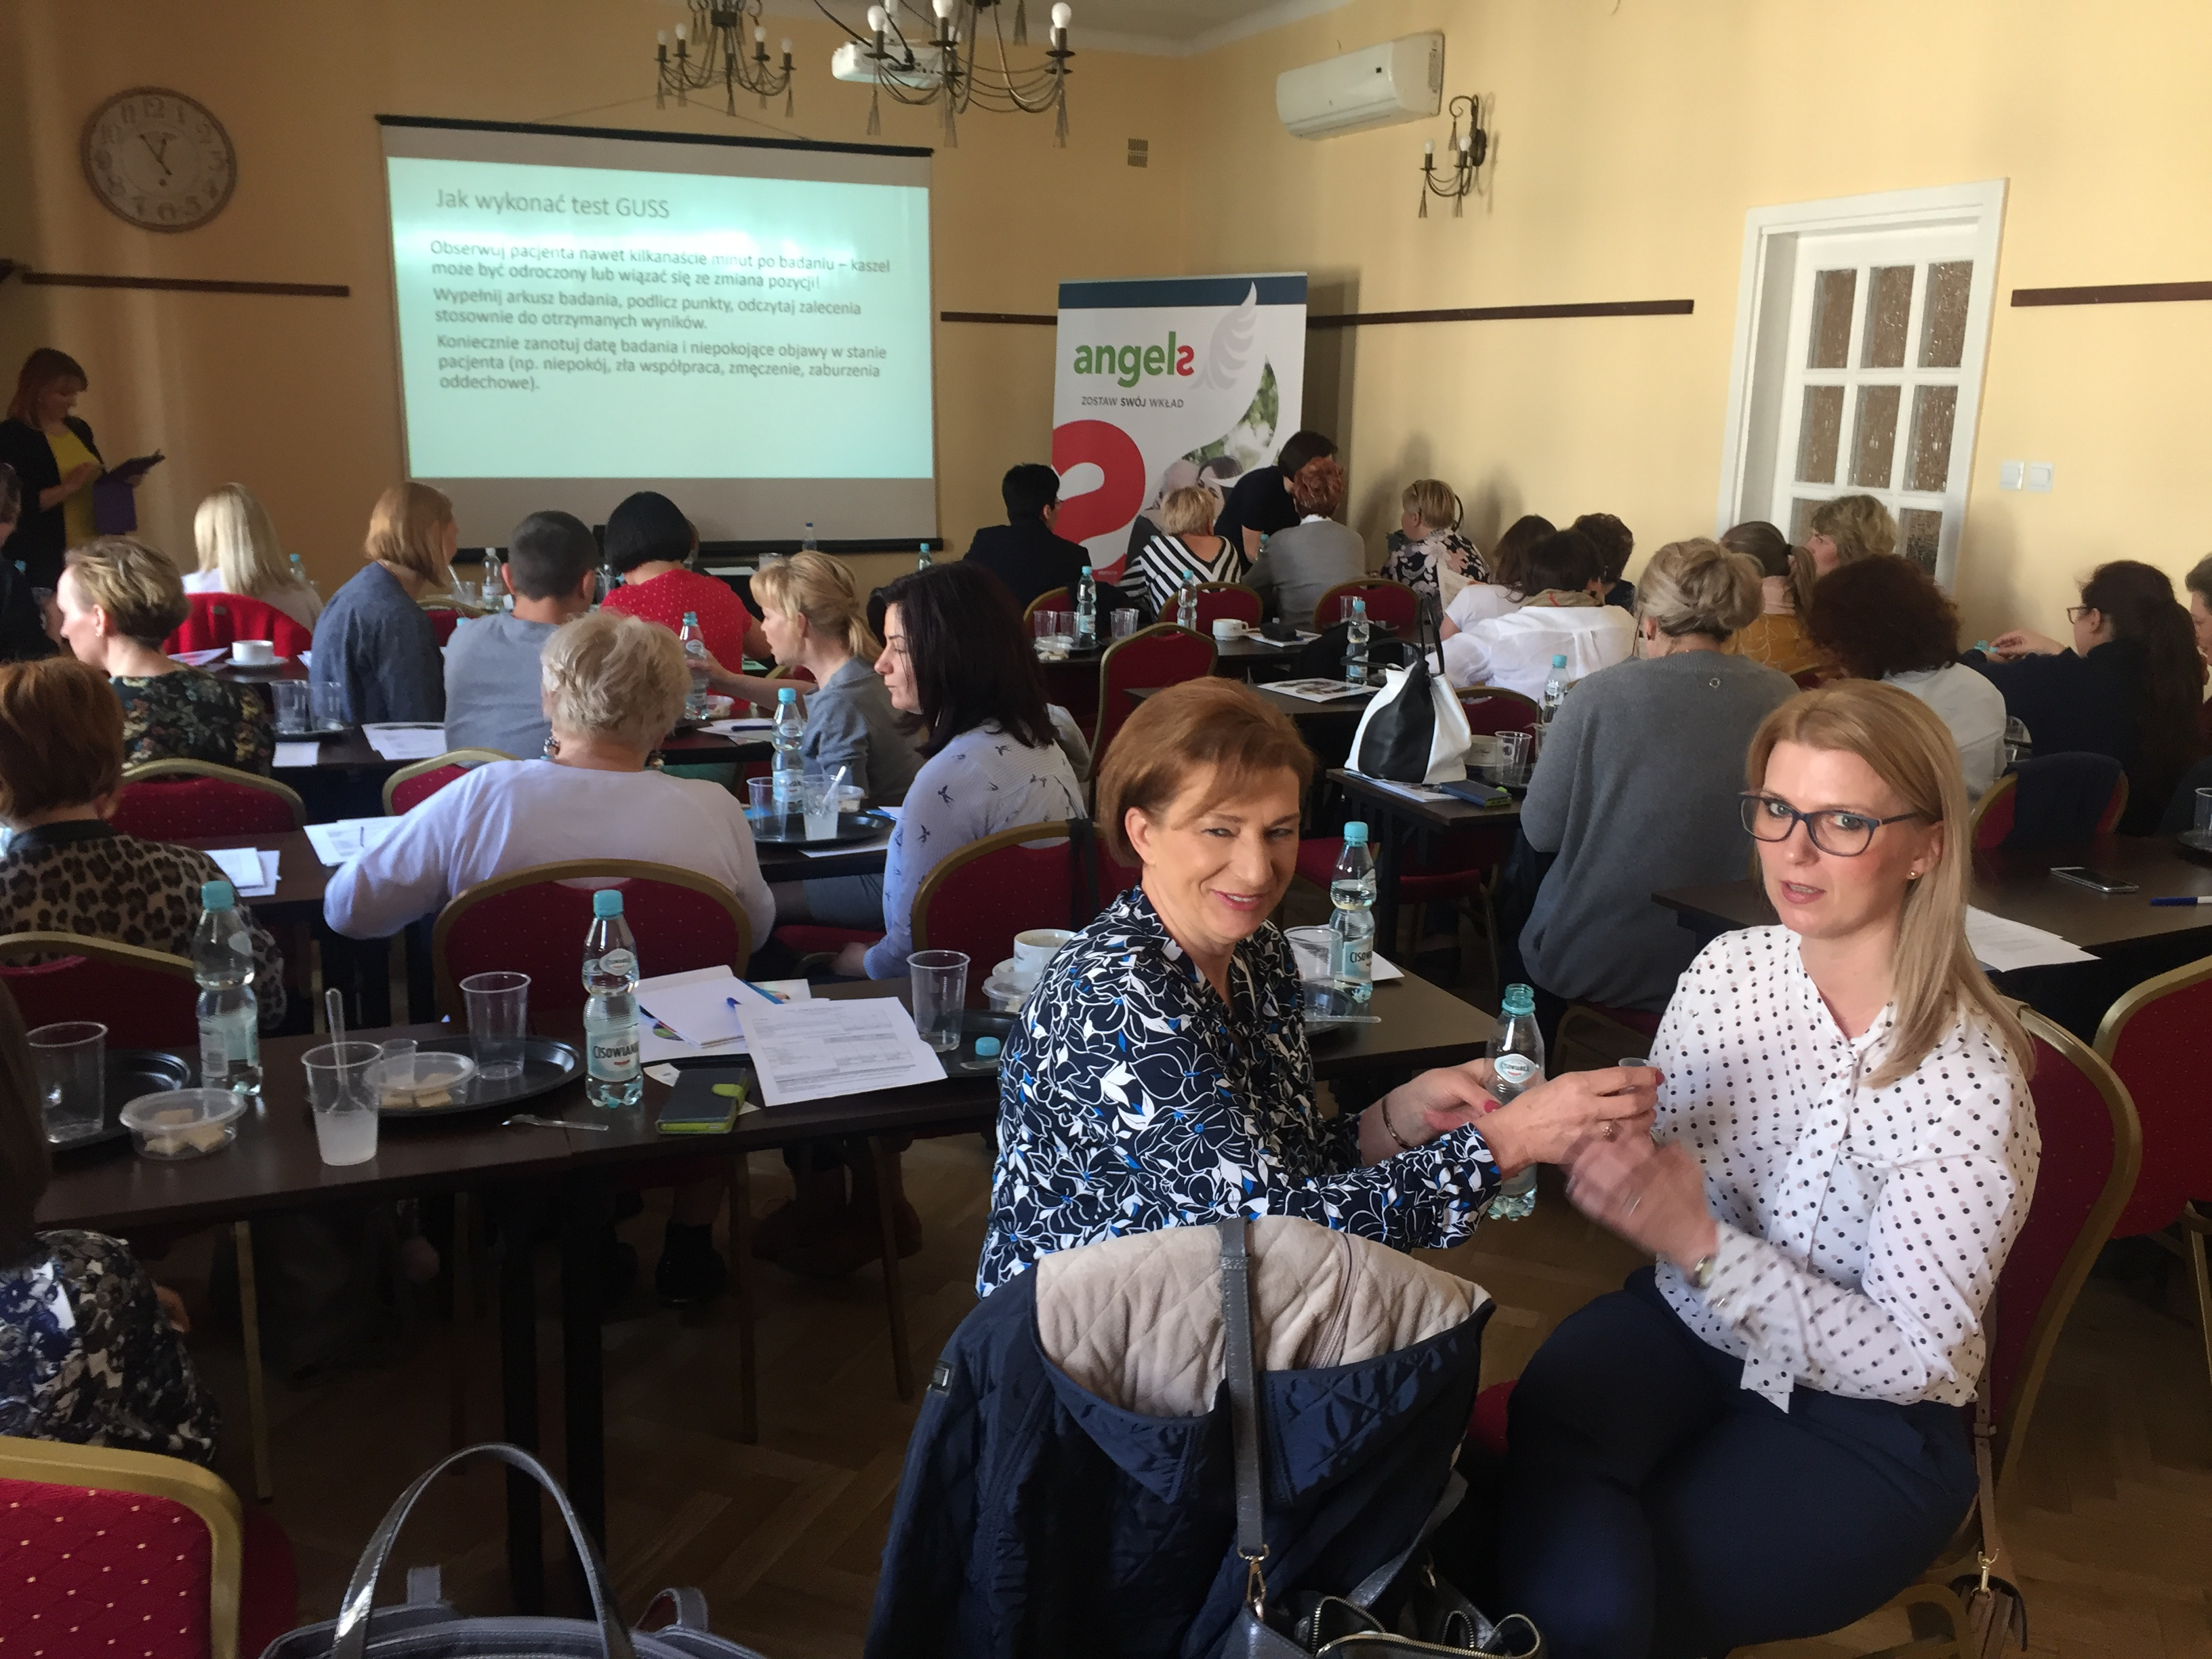
Regional nurse workshops in Poland
Standards in acute stroke treatment
Key role of nurse in acute stroke treatment
Stroke bag – benefits and needed equipment
Swallowing physiology and dysphagia. Dysphagia in stroke patients – why it’s important to diagnose early and treat properly
Suitable nutrition as a part of a treatment in stroke patients
Chosen dysphagia screening tests. Practical therapeutic tips. Performing GUSS – interactive workshops

Slide 3


Slide 4
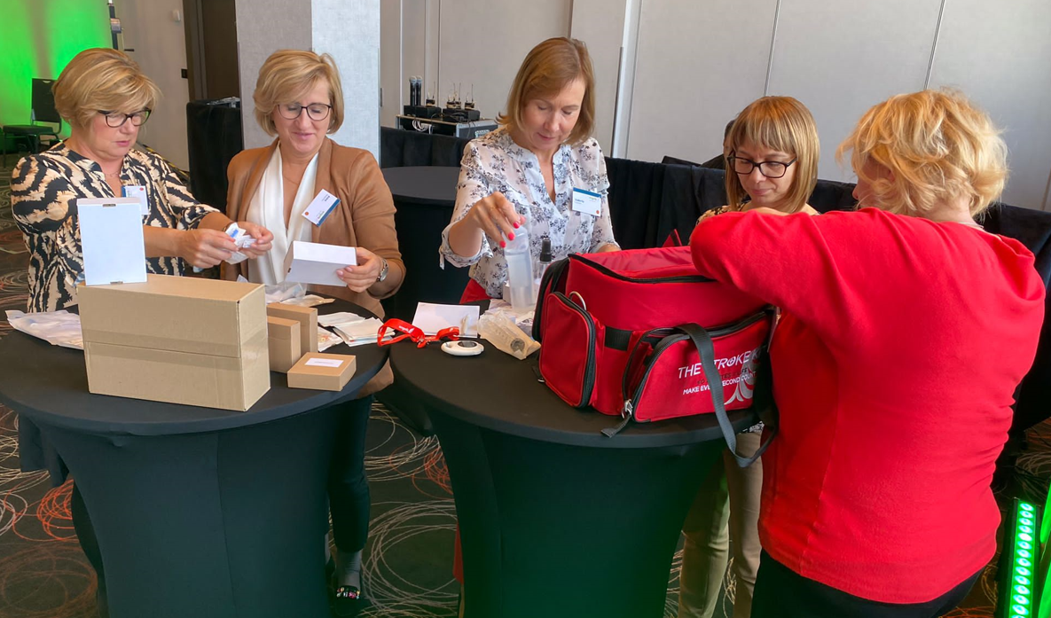
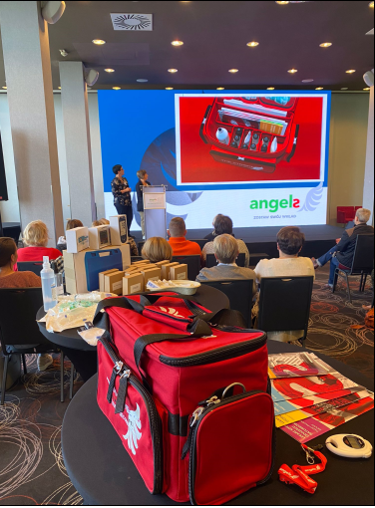
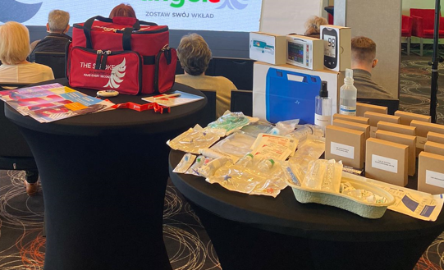
Nurse Angels Day Poland 23 Sep 2022

Slide 5
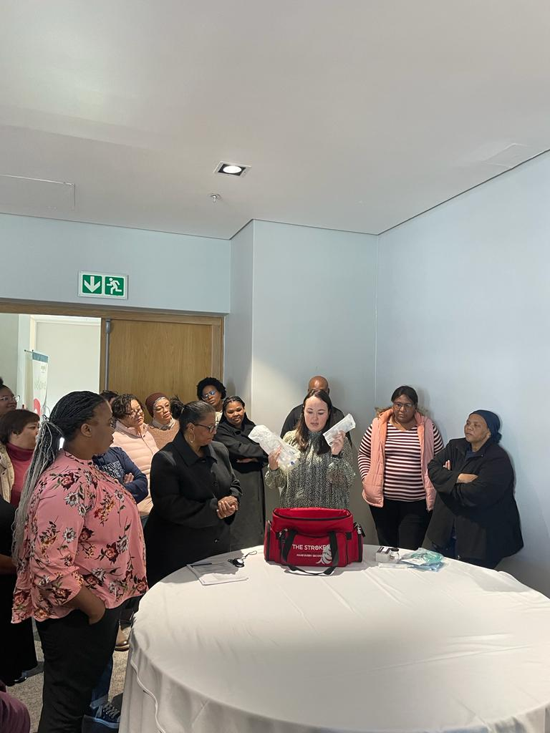
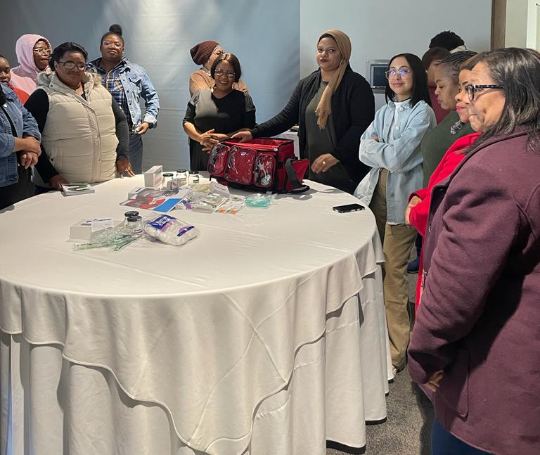
Angels Day South Africa 13 may 2023

Slide 6
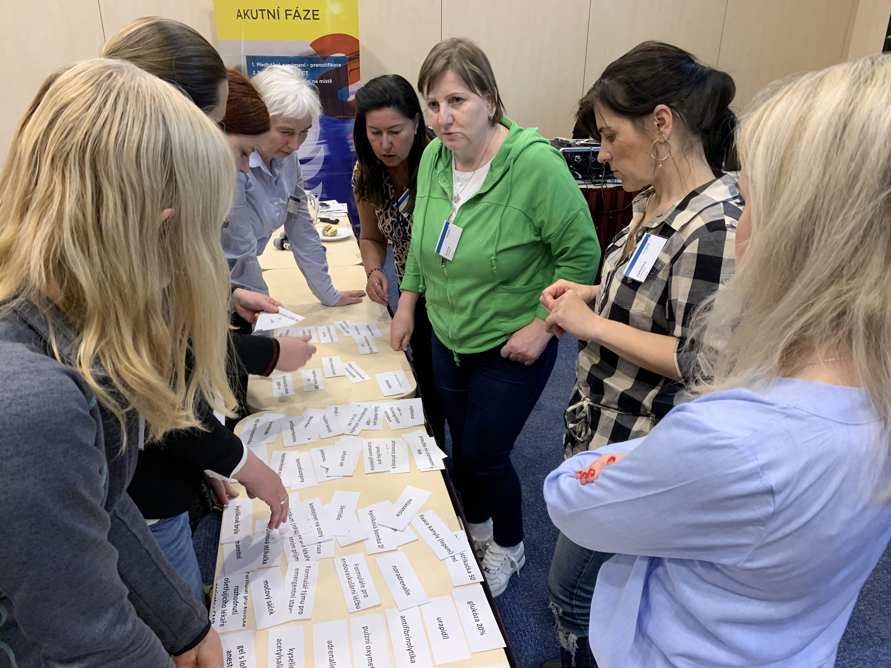
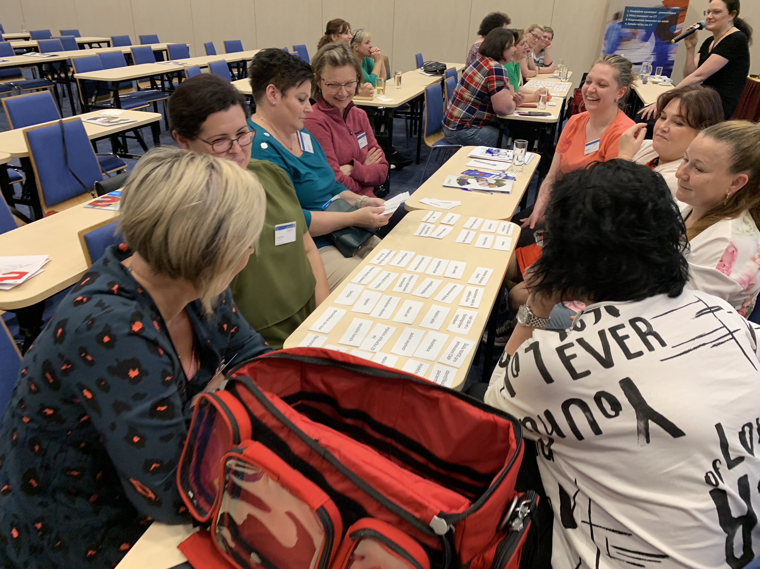
Nurse Angels Day Czech Republic 4 may 2023

Slide 7


Slide 8
Stroke bag – items NEEDED
antihypertensives
glucometer
intravenous cannulas
ED Physician Form
anticonvulsives
glucometer needles
IV extension tube
Stroke Physician Clinical Decision Form
fibrinolytic agent (rtPA) – 10 mg
blood glucose test strips
cannula fixation plaster
Registered Nurse Stroke Patient Acute Treatment Form
fibrinolytic agent (rtPA) – 20 mg
portable device for INR testing
plaster
fibrinolytic agent (rtPA) – 50 mg
INR strips
hypodermic needles
Emergency Response Team Form
prefilled syringes
10 ml with 0.9% Sodium Chloride
vacutainer set for blood sampling
double sided cannula
tourniquet
pulse oximeter
Stop watch
injection machine
Stroke patient wrist band
needleless connector
ECG leads
syringe 20 ml
disinfection
non-sterile gloves
vital signs monitor
syringe 50 ml

Slide 9
Stroke bag – items NOT NEEDED
norepinephrine
anxiolytic
cellulose wadding
stethoscope
corticoids
diazepam
hand disinfection
endotracheal intubation
antifibrinolytics
hypolipidemics
sterile gloves
oropharyngeal airway
acetylsalicylic acid
proton pump inhibitors
Foley urinary catheter
oxygen mask
statins
hypolipidemics
urine drainage bag
oxygen goggles with tubing
broad spectrum antibiotic
gel with local anesthetic
bandages
oxygen bottle 2l
myorelaxants
Ringer's solution 1000 ml
disposable bowl
oxygen tube
antidepressants
saline solution
1000 ml
GUSS Form
adrenaline
sterile water
feed thickener

Slide 10
Stroke bag – items to be discussed
H2-antihistamine
insulin
mannitol
benzodiazepines
insulin syringe
sterile gauze pads
diuretics
infusion set
paracetamol
1000 mg iv.
beta-blockers
glucose/dextrose
paracetamol
1000 mg supp.
saline solution bag 250 ml

Slide 11
Thank you!

