Slide 1
30 – 60 – 90 days Review

Slide 2

30-60-90 Day Review
STRUCTURED FOLLOW-UP FOR SUSTAINED IMPACT
Consultants revisit the hospital at:
A structured follow-up framework aligned
with Lean principles of Kaizen (continuous improvement).
DAY 30
Initial progress check and early adjustments
DAY 60
Mid-point review to reinforce or recalibrate actions
DAY 90
Sustainability check and transition to autonomy
Each visit includes an after action review (AAR) to reflect on progress, challenges, and next steps.
Enables data-driven decision-making, accountability, and team empowerment.

Slide 3
After Action Review (AAR)
4 KEY QUESTIONS
WHAT DID THE TEAM SET OUT TO DO?
AAR is a structured method for team reflection, widely
used in lean and
high-performance environments
WHAT ACTUALLY HAPPENED?
WHY DID IT HAPPEN?
WHAT ARE WE GOING TO DO ABOUT IT?

Slide 4
Question 1. What Did the Team Set Out to Do?
TASK | OWNER | DATE TO BEGIN | DUE DATE
EMS and hospital meeting | Dr Brown | 09 August 2025 | 10 September 2025
Implement EMS checklists | Dr James | 09 August 2025 | 11 September 2025
Identify direct ED/Stroke Unit numbers (bypass general reception) | Nurse Anna | 09 August 2025 | 12 September 2025
Create a stroke whatsapp group | Dr Bingley | 09 August 2025 | 13 September 2025

Slide 5


Question 2. What Actually Happened?
STRENGHTS
WEAKNESSES
DID WE
ACHIEVE
THE PROJECT OBJECTIVES?
What went right?
What problems were encountered?
What was found to be particularly useful?
What were the effects of key problem areas (e.g. on budget, schedule, etc.)
Did the teams come up with any new innovations?
Did we identify these problems as risks?
What about the final product – is it great?
What could we have done differently?
Were any new skills learned?
Is there anything in the final work-product that could have been improved?

Slide 6
Question 2. What Actually Happened?
TASK | OWNER | DATE TO BEGIN | DUE DATE | STATUS
EMS and hospital meeting | Dr Brown | 09 August 2025 | 10 September 2025 | Complete
Implement EMS checklists | Dr James | 09 August 2025 | 11 September 2025 | In Progress
Identify direct ED/Stroke Unit numbers (bypass general reception) | Nurse Anna | 09 August 2025 | 12 September 2025 | On Hold
Create a stroke whatsapp group | Dr Bingley | 09 August 2025 | 13 September 2025 | Delayed

Slide 7
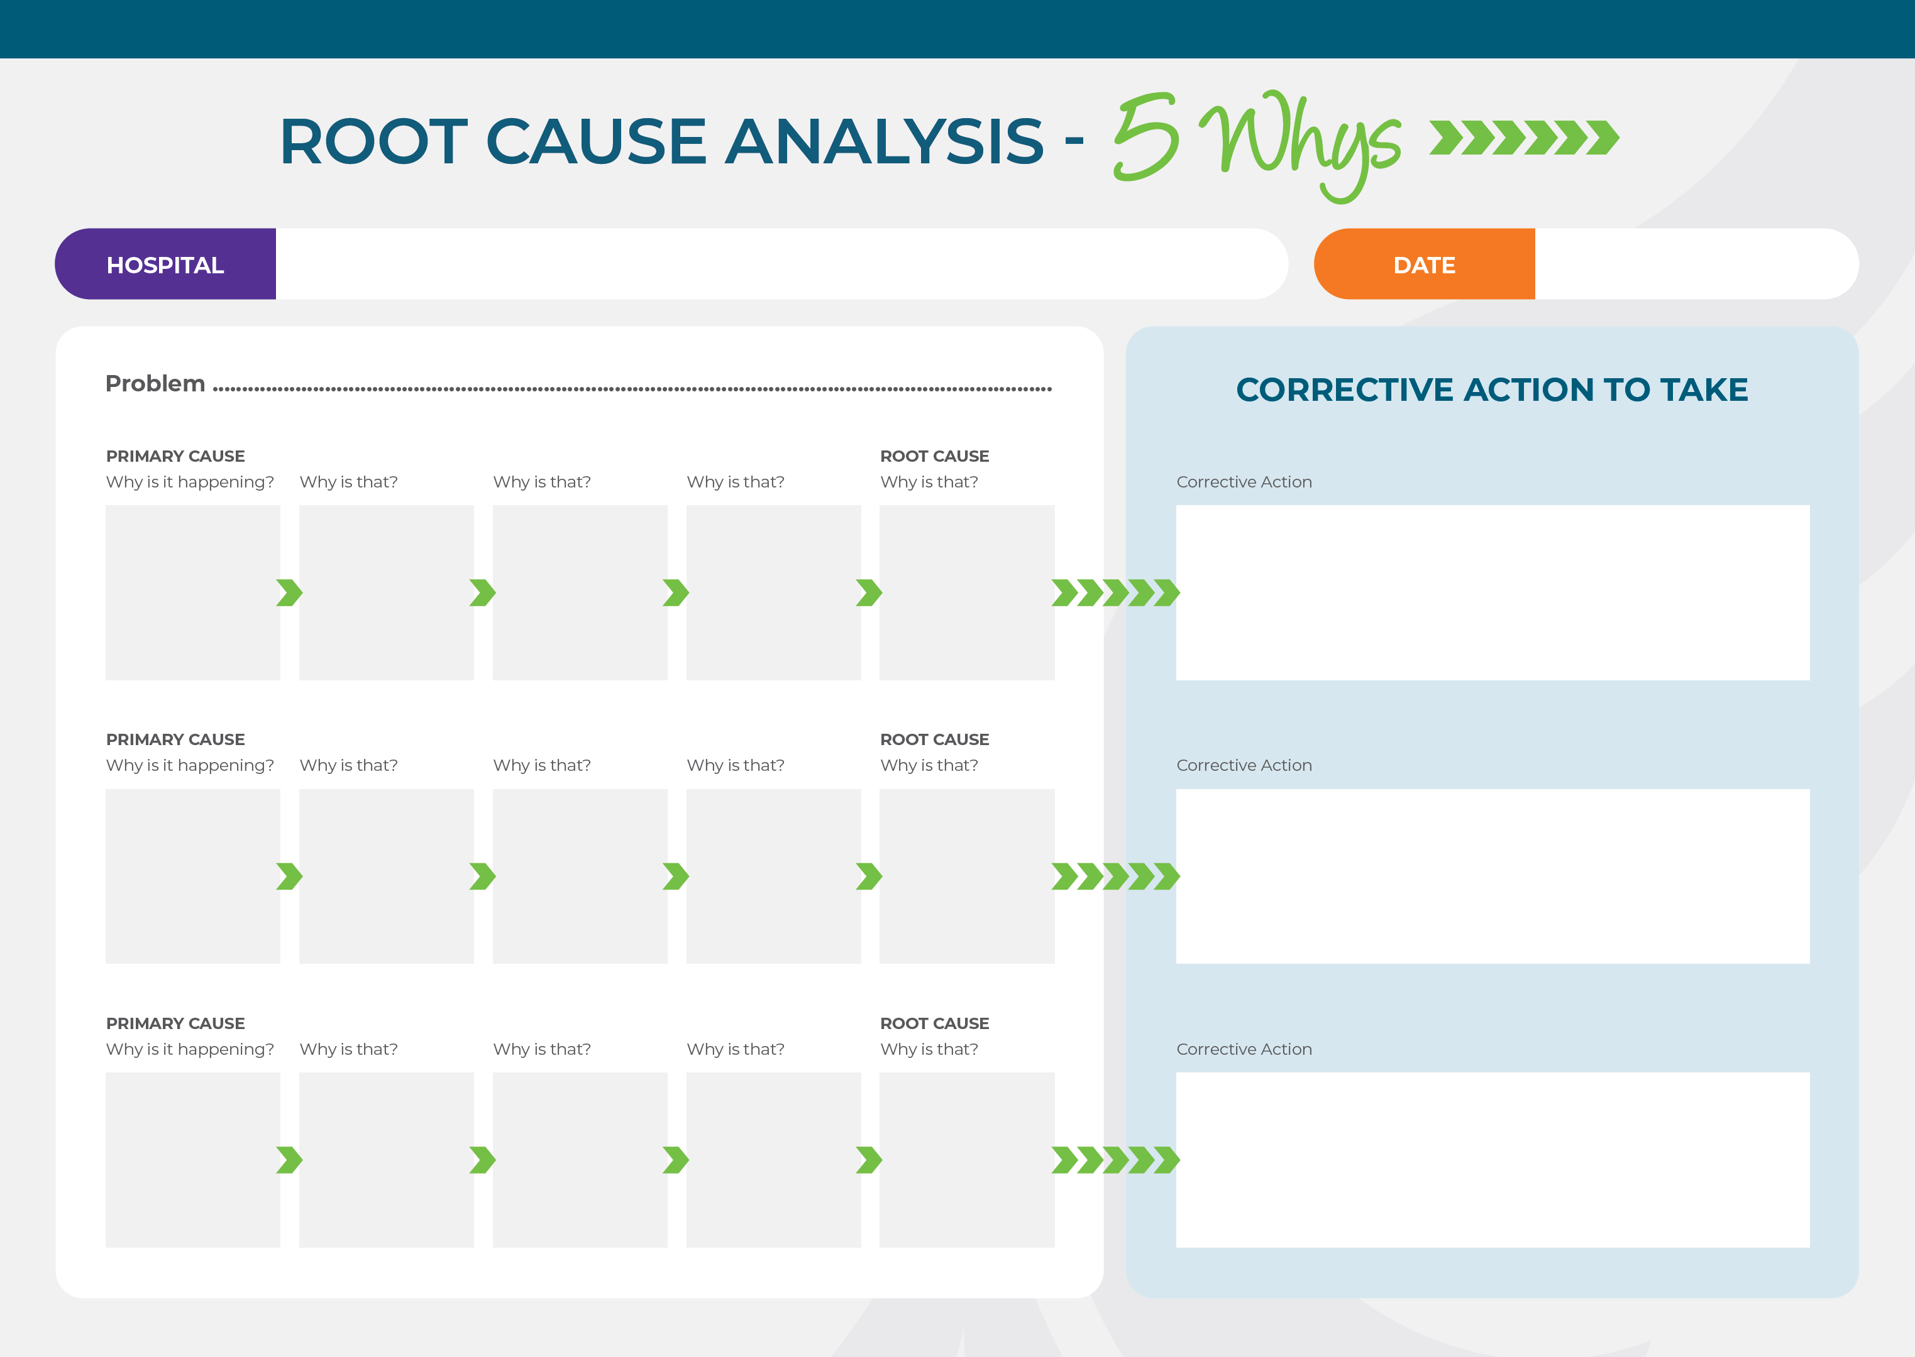
Question 3. Why Did it Happen?
Notes:
Untitled Slide
Then the third question: Why did it happen? For this,
we want to use Root Cause Analysis, also known as
RCA. It's a method of problem solving used for
identifying the Root Cause of faults or problems. It is
going to trace a problem into its origins, or
"underlying causes", to entirely prevent problem
recurrence. Here, you may like to differentiate
"causal factors" and "Root causes". Causal factors
affect an event's outcome but may not be a root
cause, so it may not prevent problem recurrence
with certainty if you only remove such causal factors.
Like a doctor diagnosing a disease, "fever" is
sometimes only the symptom of the real disease,
because many diseases may show fever, from a
common cold to several serious diseases. The
doctor always takes actions to look for the real
causes of the disease other than only treat the
symptom of fever.

Slide 8
Question 4. What are we Going to do About it?
Creative brainstorming
Transform ideas into recommendations to improve future performance (avoid previous faults & leverage strengths)
Identify timing and owners for
each action to be implemented
ACTION PLAN
WHAT - IDEA
HOW - ACTION
WHO - OWNER
WHEN - DEADLINE

Slide 9
Question 4. What are we Going to do About it?
ACTION PLAN
WHAT - IDEA
HOW - ACTION
WHO - OWNER
WHEN - DEADLINE

