Slide 1
Stroke Team Project Plan
HOSPITAL
DATE

Slide 2
Stroke Team Project Plan
HOSPITAL | NAME OF HOSPITAL
1
REGION OVERVIEW
HOSPITAL OVERVIEW – ORGANIZATION DASHBOARD
SHADOWING - WASTE WALK
SHADOWING - SPAGHETTI CHART
SUMMARY OF THE GAPS
CURRENT STATE VALUE STREAM MAP
TARGET FOR THE HOSPITAL
COMPARISON CURRENT AND FUTURE STATE VALUE STREAM MAP
OPTIMIZATION PROJECTS IDENTIFICATION
OPTIMIZATION PROJECTS PRIORITIZATION
2
3
4
5
6
7
8
9
10

Slide 3
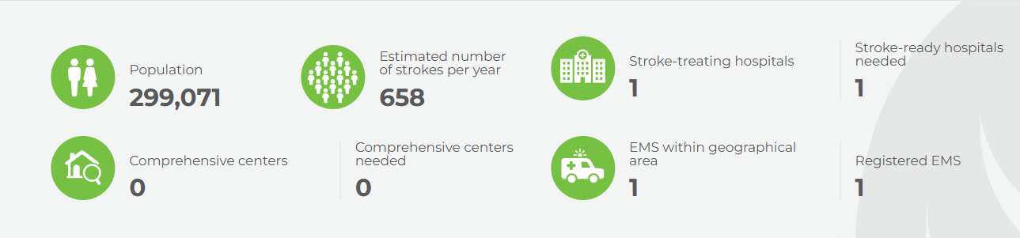
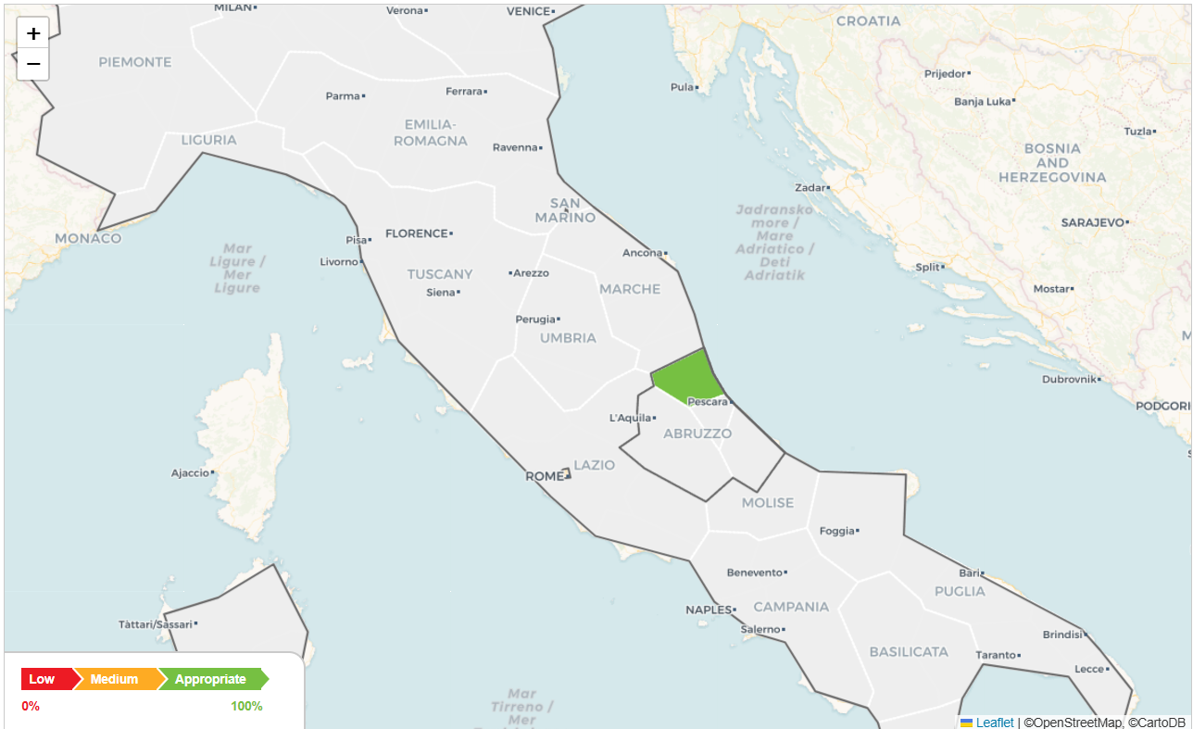
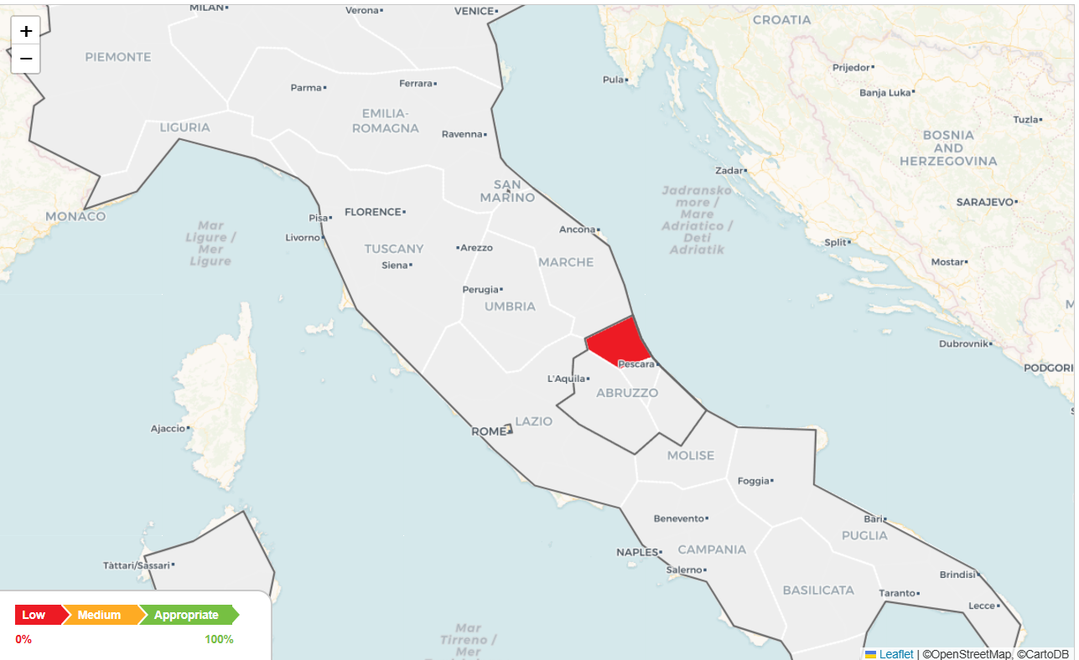
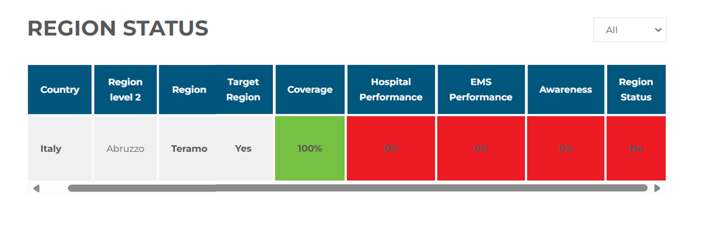
Region Overview – Teramo
HOSPITAL COVERAGE
HOSPISTAL PERFORMANCE
2025
EMS PERFOMANCE
AWARENESS
2025
Notes:
Mapky jsou schované za animací!

Slide 4
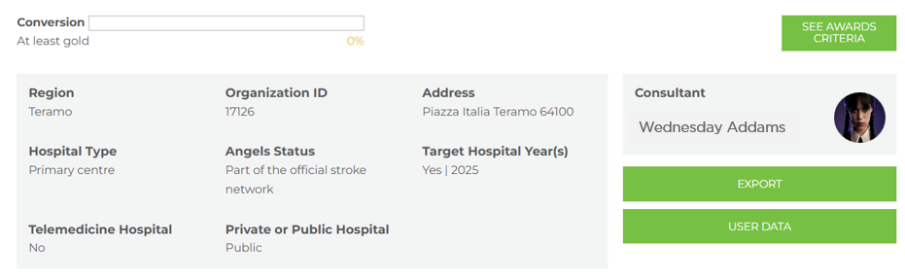
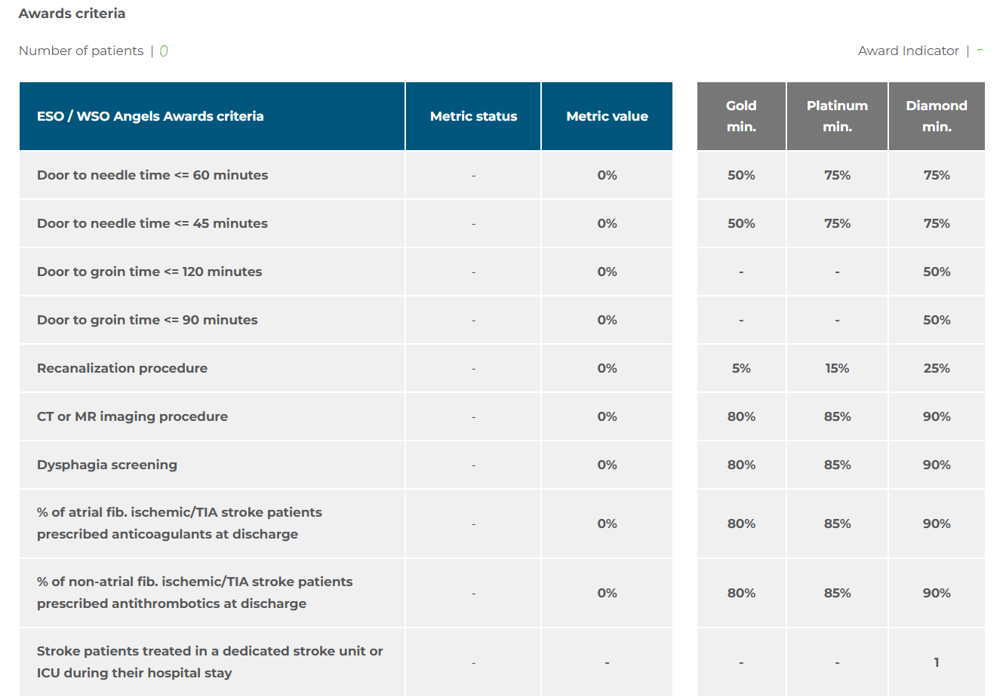
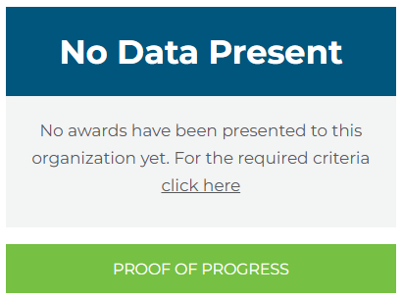
Organization Dashboard
HOSPITAL | NAME OF HOSPITAL

Slide 5


Shadowing - Waste Walk
 | TRANSPORTATION Unnecessary movements of products, patients & materials | INVENTORY Excess supplies or medications not immediately needed | MOTION Excessive movement by staff due to poor layout or workflow | WAITING Wasted time when patients or staff are waiting for the next step
FINDINGS
 | OVER PRODUCTION Doing more than what is needed or before it's needed | OVER PROCESSING Redundant or unnecessary steps in care delivery | DEFECTS Errors in diagnosis, documentation, or treatment | SKILLS Underutilizing people’s talents, skills, knowledge
FINDINGS

Slide 6
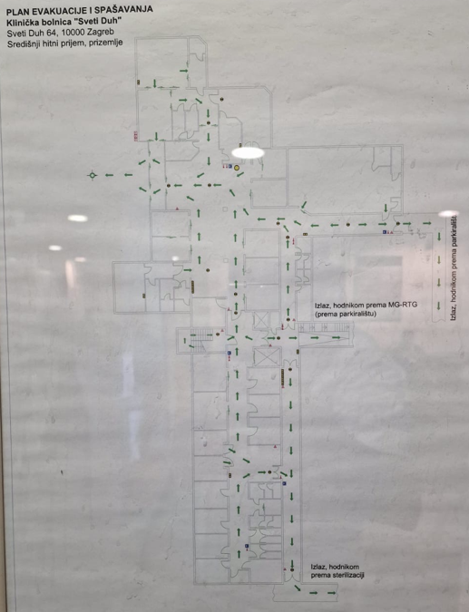
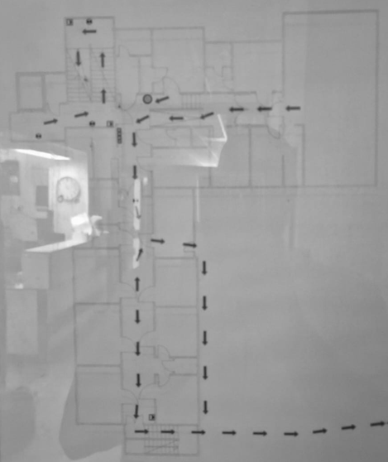












Shadowing - Spaghetti Chart
Emergency Department
(Ground floor)
Radiology Department
(Mezzanine floor)
Stroke and Intensive Care Unit
(another pavillon)
Shock Room
Elevator
ICU
Triage
Entrance
CT
Waiting Room
Elevator
Elevator
CT

Slide 7
Summary of the Gaps
Gap | Recommendation
Notes:
Data retrieved from HRF

Slide 8
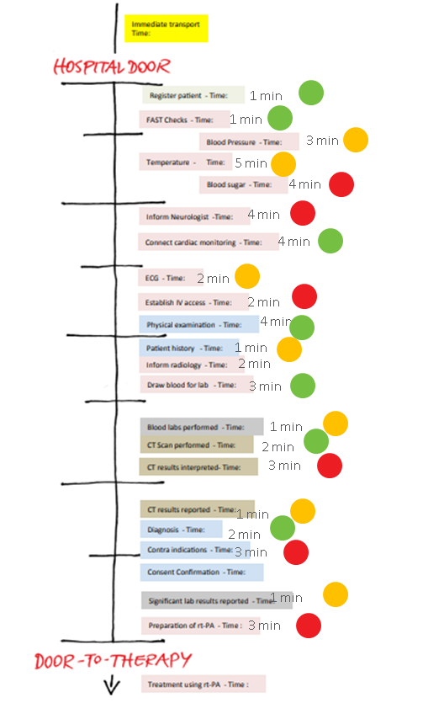
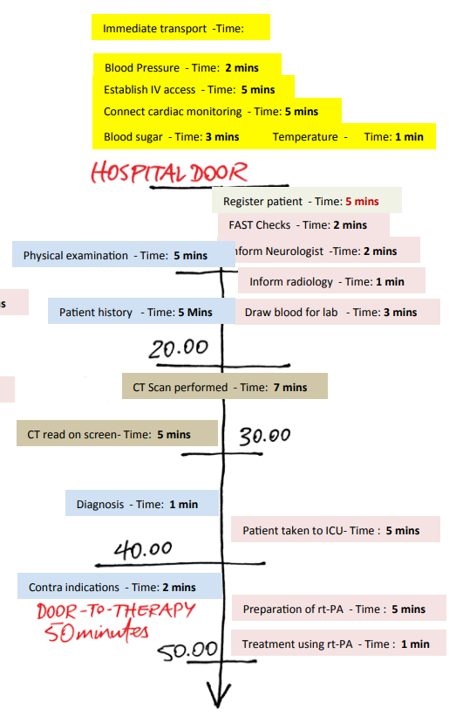
Current state Value Stream Map
PATHWAY A
PATHWAY B
Notes:
(pathway A & B) EXAMPLE TO BE REPLACED WITH THE ONE CREATED DURING THE WOSKHOP (USE PICTURES)

Slide 9





Target for Hospital
is
NAME OF HOSPITAL
 | GOLD STATUS | PLATINUM STATUS | DIAMOND STATUS
% of ischaemic stroke patients treated with door to needle time <= 60 minutes | 50% | 75% | 75%
% of ischaemic stroke patients treated with door to needle time <= 45 minutes |  | <50% | 50%
% of ischaemic stroke patients treated with door to groin time <= 120 minutes | 50% | 75% | 75%
% of ischaemic stroke patients treated with door to groin time <= 90 minutes |  | <50% | 50%
% recanalisation procedure rate out of total ischaemic incidence | 5% | 15% | 25%
% of all suspected stroke patients undergoing CT/MR imaging procedure | 80% | 85% | 90%
% of all stroke patients undergoing dysphagia screening | 80% | 85% | 90%
% of non-atrial fib ischaemic/TIA stroke patients prescribed antithrombotics at discharge | 80% | 85% | 90%
% of atrial fib ischaemic/TIA stroke patients prescribed anticoagulants at discharge | 80% | 85% | 90%
Stroke patients treated in a dedicated stroke unit or ICU during their hospital stay |  |  | YES
Notes:
TARGET FOR THE HOSPITAL

Slide 10
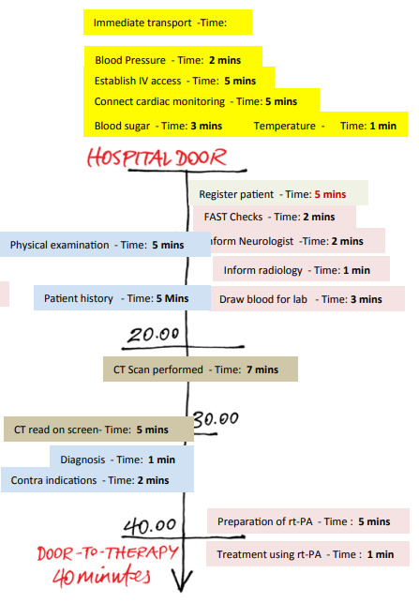
Comparison Current and Future State Value Stream Map
PATHWAY A
PATHWAY B
PATHWAY C
Notes:
EXAMPLE

Slide 11
Optimization Projects Identification
 | Project | Goal
1
2
3
4
5
6

Slide 12
Optimization Projects Prioritization
Impact
1
2
3
Feasibility
4
5
6

Slide 13
Notes:
We need 1 page executive summary of this doc that they can sign (STROKE TEAM PROJECT PAN DOCUMENT)

