Slide 1
In hospital simulation

Slide 2
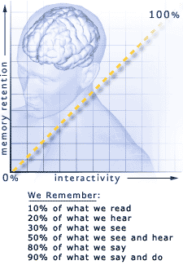
Simulation - learning Process
Teach Others 90% Collaborative Simulations
Learn By Doing 75% Simulations
Discussion Groups 50% Web Seminars, IM, chat
Demonstration 30% Animation
Audio Visual 20% PowerPoint Slides
Lecture 5% Streaming media
Source: Andersen Consulting
Najjar, L. J. (1998). Principles of educational multimedia user interface design. Human Factors, 40(2), 311-323.

Slide 3
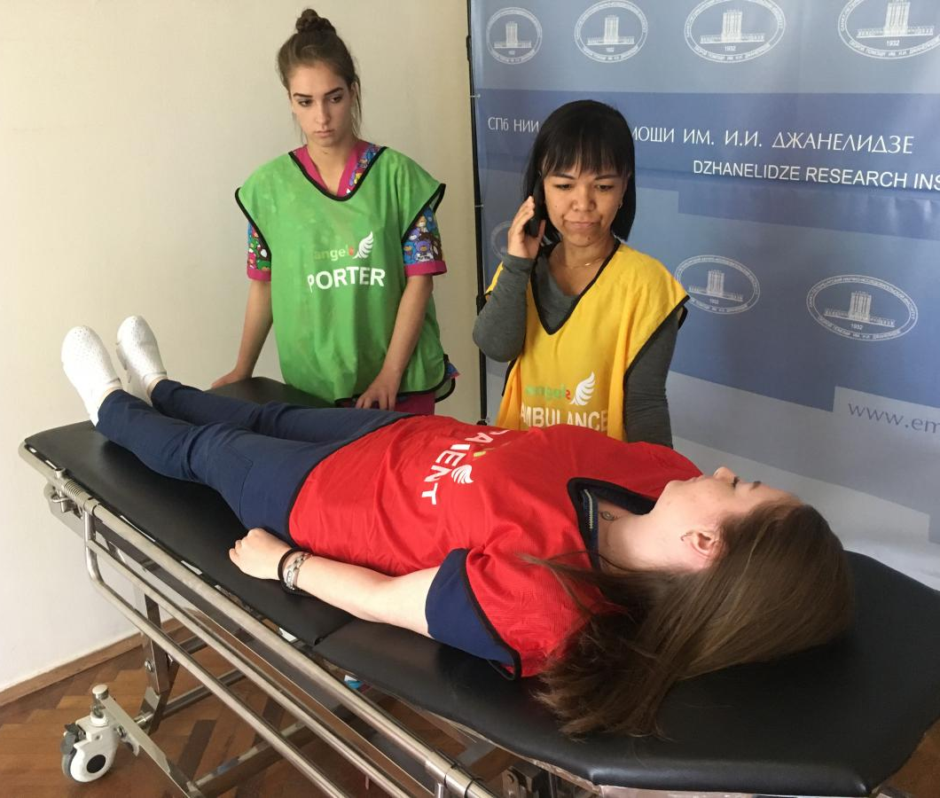
In hospital simulations
Immersive learning
Safe context
Team experience
Reduction of the errors
Improve the patient safety
Cognitive
Emotional
Psychomotor
Do
Reflect
Apply

Slide 4
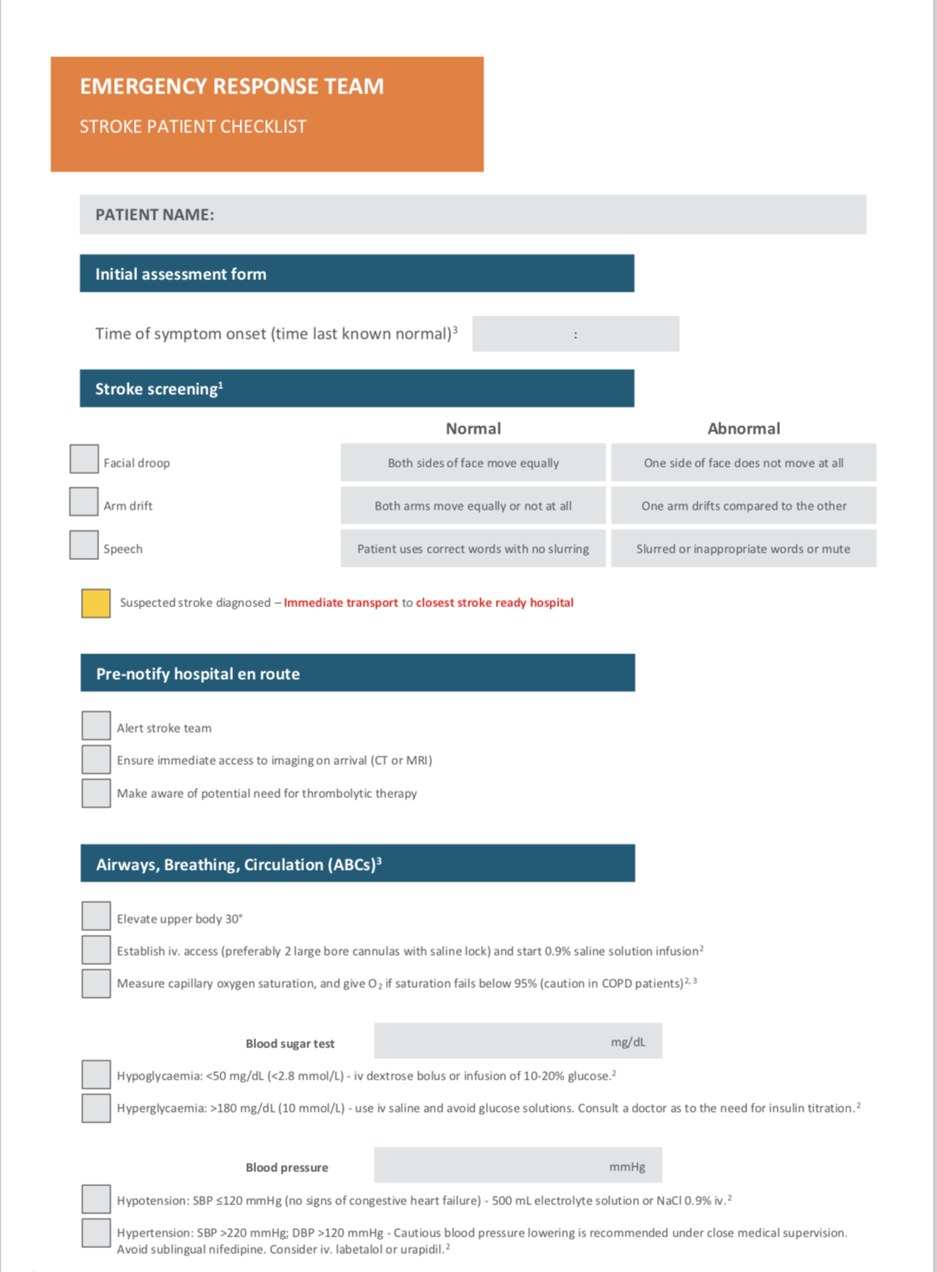
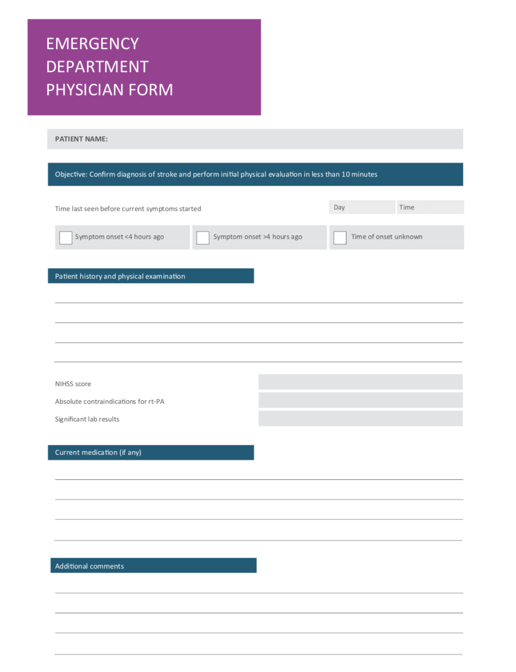
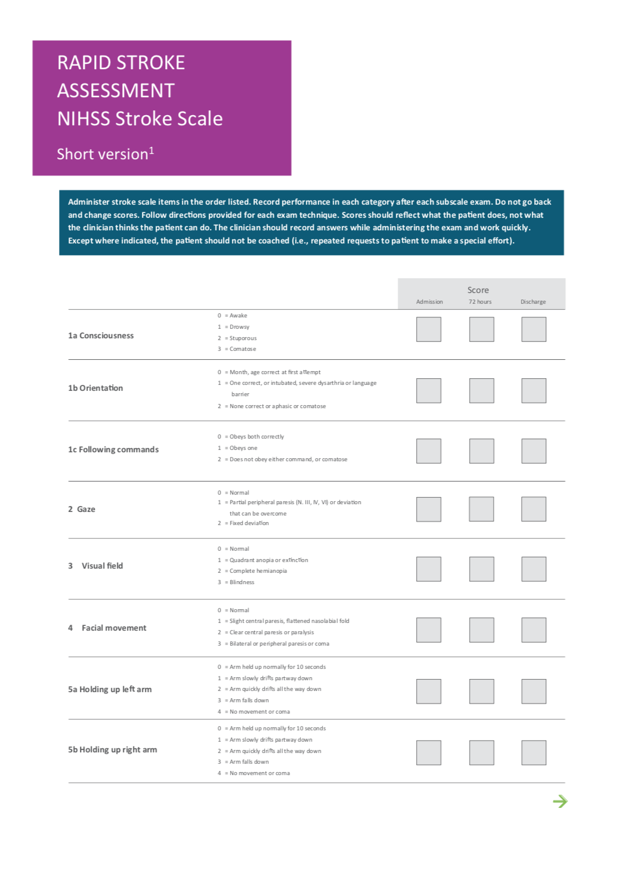
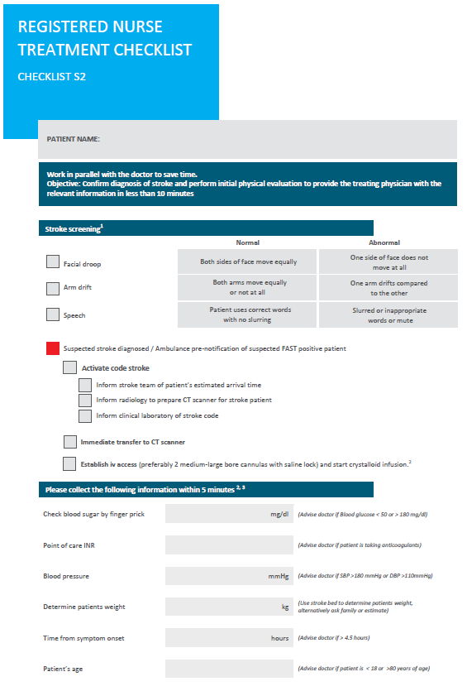
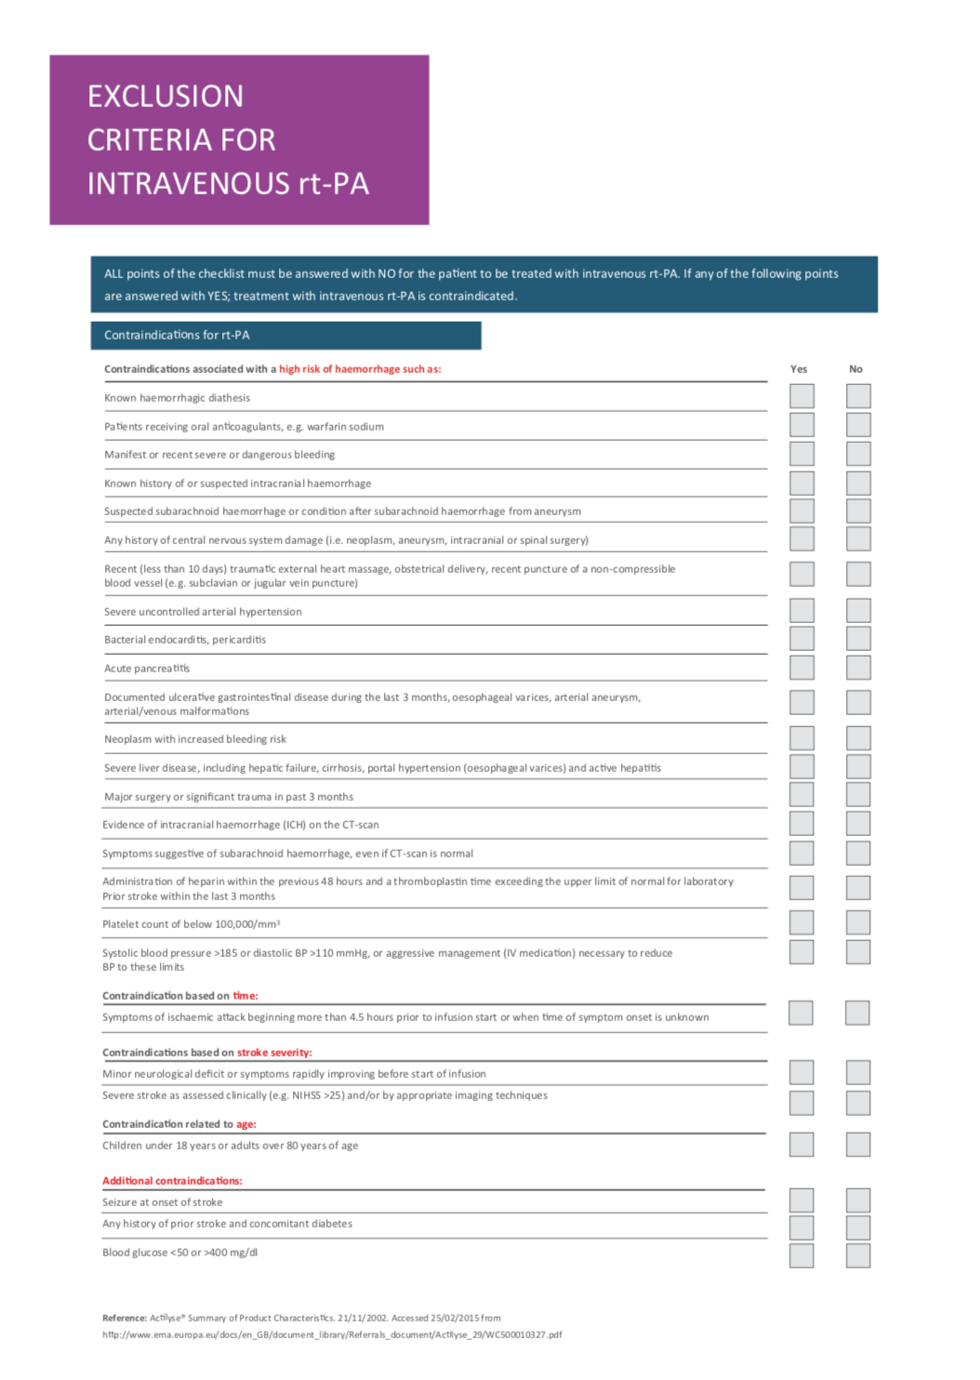
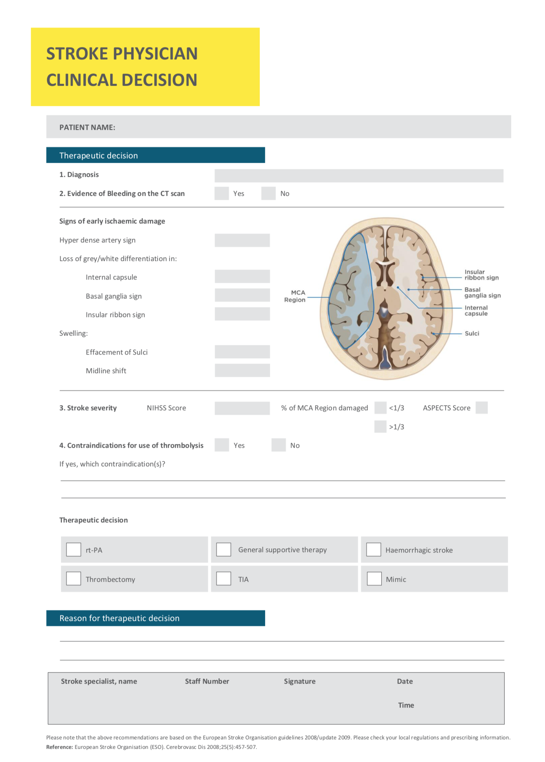
Simulation promotes the use of checklists for safer healthcare

Slide 5
Goals depending on the type of simulation
Angels consultancy process
First simulation: the objective is to identify bottlenecks on the current Stroke patient pathway and discuss a new pathway that will decrease the DTT time.
Second simulation: test the new pathway and agree on priority actions for implementation.
Angels Lean consultancy process
Current-state simulation: the objective is to gain a clear picture of the current situation and to support mapping of the existing process.
Future-state simulation: the objective is to test the newly agreed pathway in a safe, controlled environment, before real-life implementation.

Slide 6
How to organize the in hospital simulation
MAIN STEPS
Before
During
After

Slide 7
How to organize the in hospital simulation
MAIN STEPS
Before
During
After
Presentation of the activity: when-how?
Invitation mail
Forms
Materials to prepare

Slide 8
Invitation mail – all the details required!
Dear xx,
Here are some indications for the organization of the in hospital simulation at the Hospital xxx which will be held, as agreed, on 17th of March 2026 from 1 pm to 4pm.
Description: The purpose of the simulation is to test the stroke path and identify any critical issues and areas for improvement. The simulation is an itinerant activity, which therefore takes place in the departments, starting from acceptance in the PS up to possible treatment, and involves all the actors of the stroke team (EMS, Emergency, Neurology, Lab analysis, Radiology).
Who involve: The team participating in the simulation will involve the main actors involved in the stroke process, therefore:
Patient and family member (actors can be chosen from among staff members)
Nurse and doctor of EMS
Triage Nurse
Emergency physician and nurse
Neurologist
Stroke Unit Nurse
Radiologist
Radiology technician
Laboratory analysis technician

Slide 9
All other participants in the activity will have the role of take note of any observations and comments reported during the simulation.
Agenda:
Introductory briefing: sharing of the objectives of the activity and definition of roles.
Simulation: each participant will return to their department and will wait for the activation of the stroke code.
Debriefing
What do we need?
Authorization by the hospital management to carry out the simulation and video shooting with Go-pro (form attached);
Availability of a classroom/room where we can meet in the briefing and debriefing phases, with the possibility of projecting and, if possible, a flip chart;
Alert the managers of the departments of the conduct of the simulation;
Identify the actors who will participate in the simulation;

Slide 10
Some useful information:
All actions will be simulated, including any invasive actions, such as insertion of the bladder catheter (the gesture is simulated), second venous access (the cannula needle is placed "without inserting it" with a plaster), any drug therapy;
The only actions that are actually carried out are the acceptance of the patient for triage, execution of the request for tests and blood sampling (to evaluate the execution times of the test);
In radiology the patient will be placed on the CT table, the execution time will be simulated, and the images will be shown in real time by the Angels consultant;
It is preferable that the operators are not on duty at the time of the simulation, to avoid creating discomfort;
It is essential that simulation participants can participate in the debriefing;
Attached you will find:
Authorization to carry out the simulation to be signed.
I invite you to share this information with your colleagues, so that you can organize yourself in accordance with shifts and availability. For any further information do not hesitate to contact me.
With regards,
Angels

Slide 11
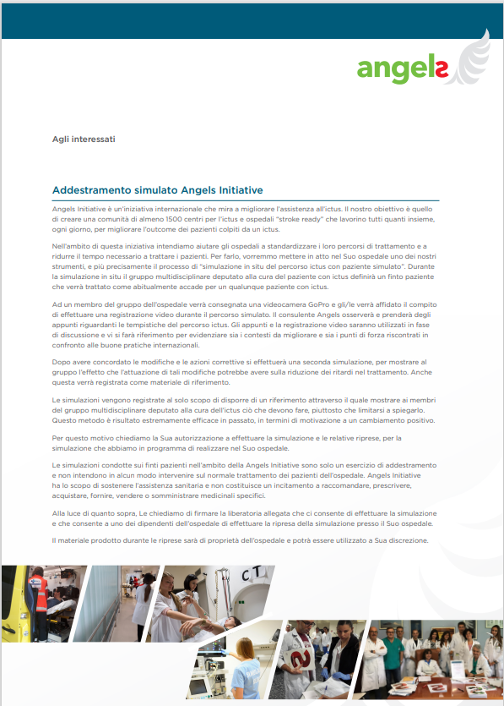
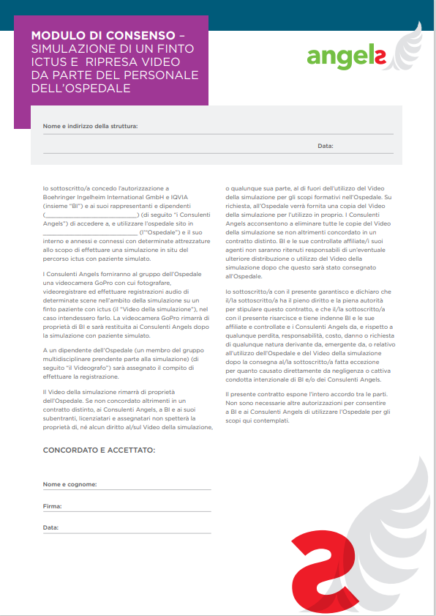
3. Forms
Simulation &
Video/Photo
Release form

Slide 12




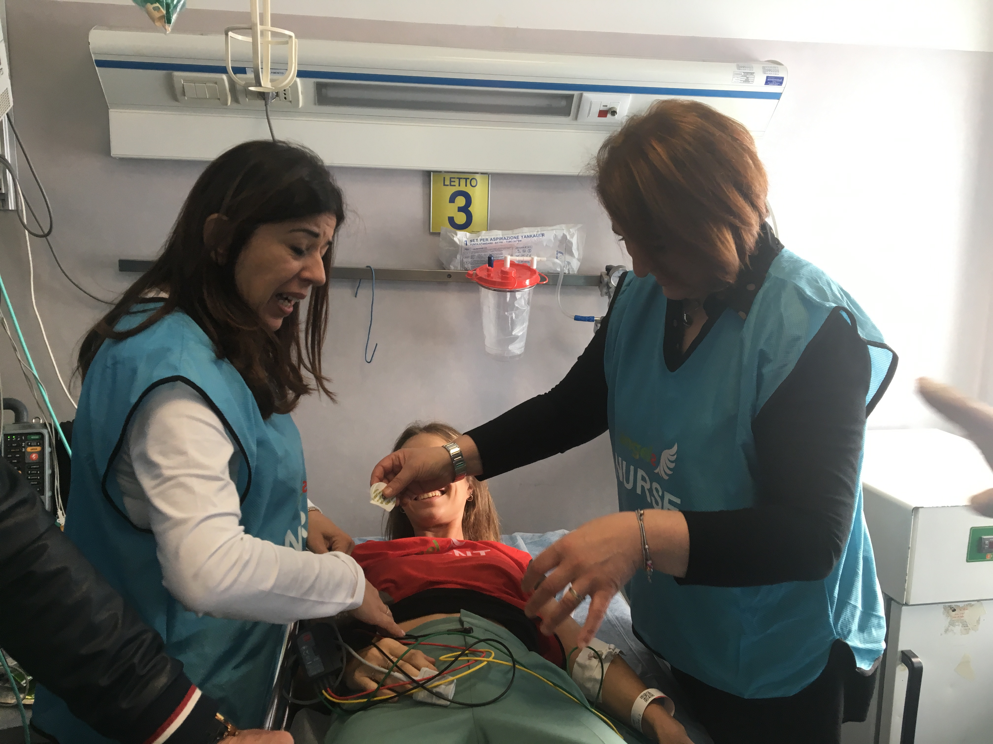


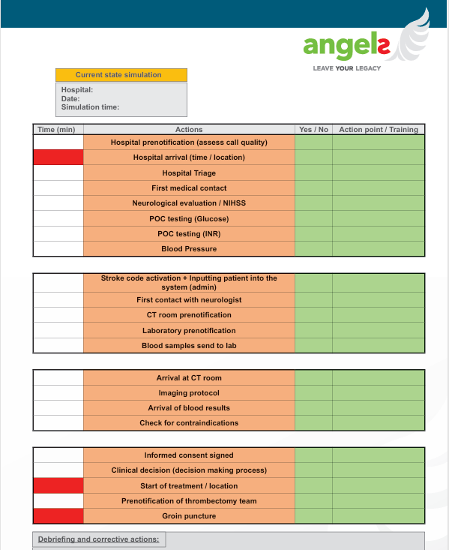

4. Material to prepare: stroke bag & consultant tools

Slide 13


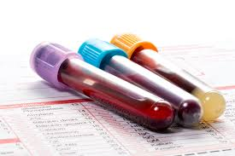
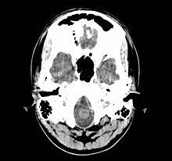
Actions to pre-agree with the team
The organization need to be as more realistic as possible
Clinical case
Lab analysis
CT scan images
Patient registration

Slide 14
How to organize the in hospital simulation
MAIN STEPS
Before
During
After
Briefing
Simulation
Debriefing

Slide 15
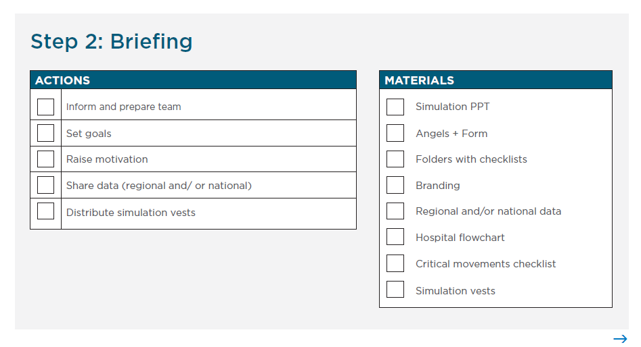

Slide 16
Set the roles
Actors
Observers
  Patient
  Family member
STROKE TEAM:
  Triage nurse
  Emergency physician
  Emergency nurse
  Neurologist
  Stroke Unit Nurse
  Neuroradiologist
All the others participant that will follow the activity.
They will collect all the notes and observations in a specific form, that will be discussed later
Movie Maker
Filming with the smartphone or GoPro
Angels Consultant
Registration of times and main actions

Slide 17

Set the rules
DON’T CHEAT
LET’S CHALLENGE YOURSELF
IT’S A SIMULATION,
NOT A PLAY
LET’S FIND SOLUTIONS TO PROBLEMS

Slide 18

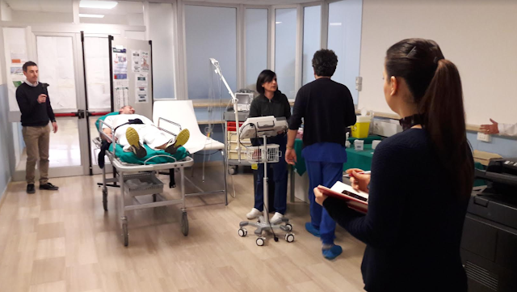

Slide 19



The three phases of debriefing
REACTION
KNOWLEDGE
SYNTHESIS

Slide 20
1. REACTION
“Change the scene” and set up the discussion
How do you feel?
Facts

Slide 21
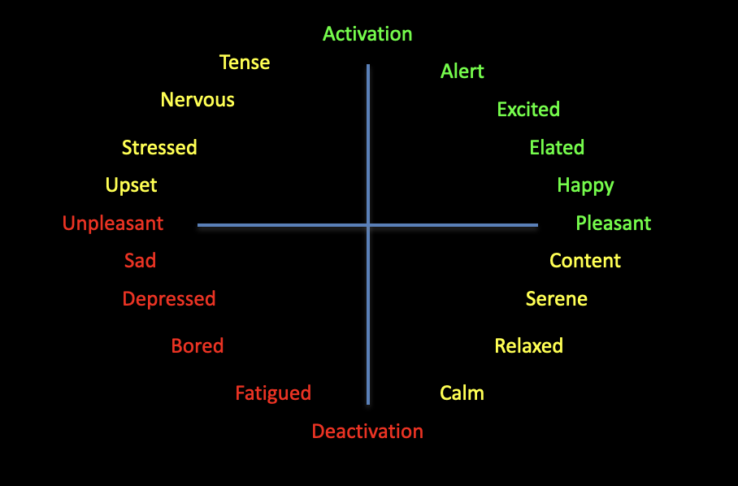
Black hole of emotions: express yourself!
Notes:
Russell and Feldman-Barret thing → interaction with audience
Helpful for the discussion?

Slide 22



2. KNOWLEDGE – Analyze and Apply
Exploring
the participant's perspective on the events of the scenario
Discussion and teaching
Help participants to navigate new perspectives, knowledge and skills
Generalyze
and apply what has been learned to real environments
WITH A PINCH OF GENUINE CURIOSITY!
Notes:
2° step – Plus & Delta Analysis

Slide 23
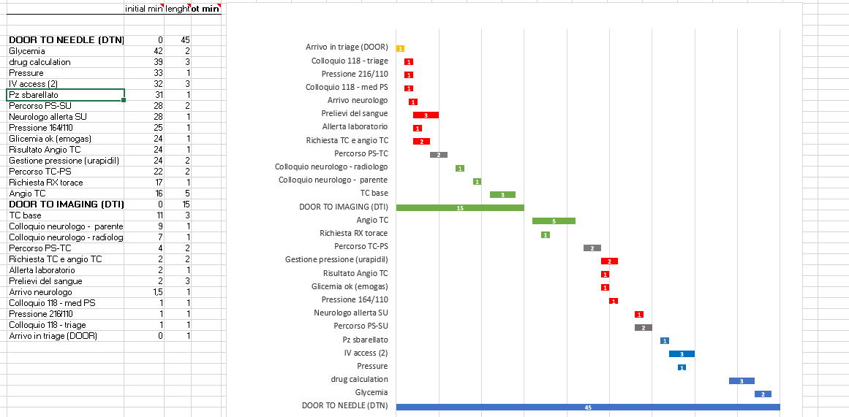
2. KNOWDLEDGE - Talk about facts (not people)
Time delays

Slide 24
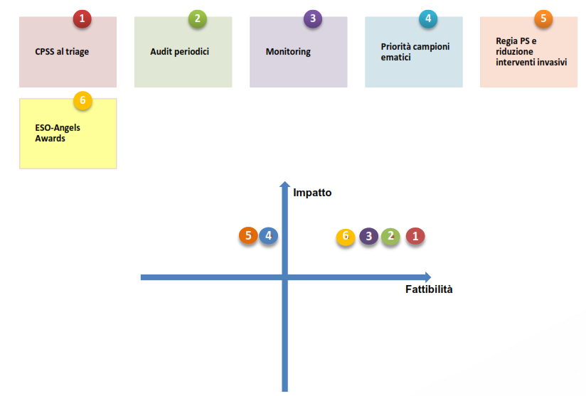
3. SYNTHESIS
IMPROVING ACTIONS
Use a checklist to collect patient history and family member telephone number | 1
Use a checklist to list the priority actions the nurse has to do in the ED | 2
Treat at CT, use the stroke bag | 3
ED training on the priority actions | 4
Additional CT scan in ED | 5

Slide 25


It’s not just «giving feedback»… it’s having a conversation
Notes:
There are ways and ways of doing a debriefing... debriefing is often perceived as a not very important activity, The team is not motivated and when you introduce a debriefing you could have a reaction like this....

Slide 26


The debriefing molecule
https://harvardmedsim.org/resources/debriefing-molecule/
Notes:
Dove la mettiamo??

Slide 27

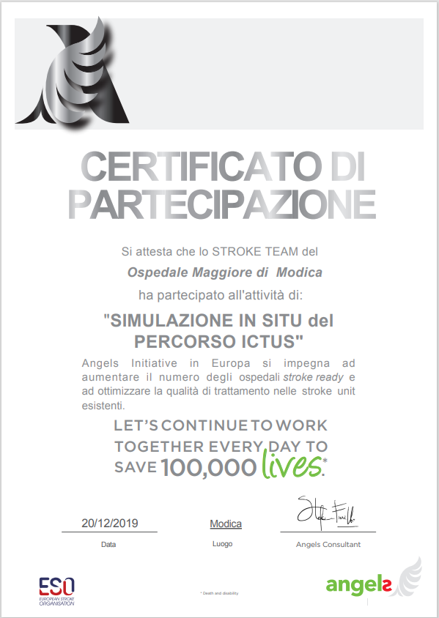
Team picture and certificate

Slide 28
How to organize the in hospital simulation
MAIN STEPS
Before
During
After
Thank you e-mail

Slide 29
How to organize a hospital simulation activity
MAIN STEPS
Introduce the activity
Send the invitation e-mail
Consent signed
Prepare the stroke bag
Print/prepare all the other materials
Be sure to charge the Go-pro and free up the memory card
Prepare the room for the debriefing
Be sure that everything is clear during the briefing
Give the roles and the rules
Brief the patient and the family member
Debriefing: video, times, +/Δ
Action plan
Group picture
Send thank you e-mail
Send the videos of the simulation
Follow up
Before
During
After

