Slide 1
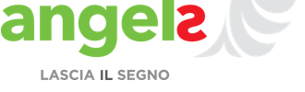
Workshop Angels
HOW TO STRUCTURE AN EFFECTIVE DEBRIEFING SESSION

Slide 2

Directing the rider
Notes:
Script the critical moves. Be concrete and specific about what actions you want them to take – the more detailed and actionable, the better.

Slide 3
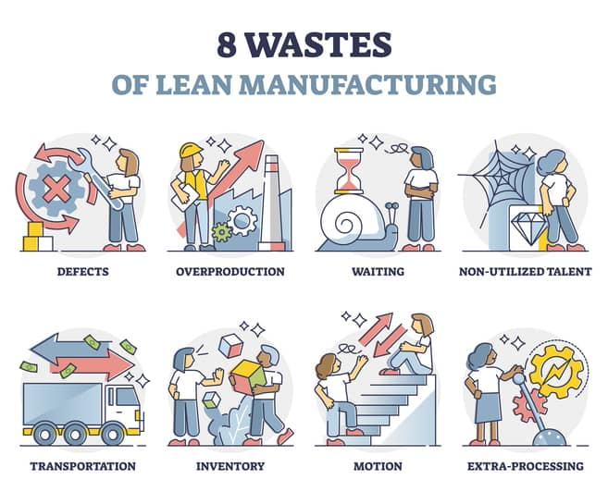
Motivating the elephant
patients waiting too long; employees waiting because a lack of efficiency
waiting
unnecessary actions
(i.e. diagnostic procedures)
over-production
over-processing
too many forms filled out; data never used
8 LEAN
WASTES
missing items; wrong drug administration
defects
non-used talent
employees non involved in the pathway
long distance storage of useful items; radiology dept located far from the ED
expired supplies that must be disposed of; lack of drugs
transport
stock
motion
physician walking miles per day due to poor hospital layout
Notes:
Grow your people. Help your people develop a sense of identity that relates to the change and cultivate a growth mindset

Slide 4

Shaping the path
Notes:
Tweak the environment. Make a change to the situation that will change behavior.

Slide 5
Simulation is…
A created and guided artificial experience capable of mimicking real-world processes or conditions to satisfy certain educational, evaluation and research objectives.
A strategy, not a technique, to mimic, anticipate or amplify real situations through a guided experience in a totally interactive way.
Simulation is an experience capable of creating an "intelligent" relational space in which the more the subjects and the environment interact spontaneously, the more the social construction of reality is likely to be experienced as a possible reality that stimulates the embodied cognitive mechanisms of the people (Dojmi and Muzi; 2018).
The simulation is the real excuse to have a debriefing

Slide 6
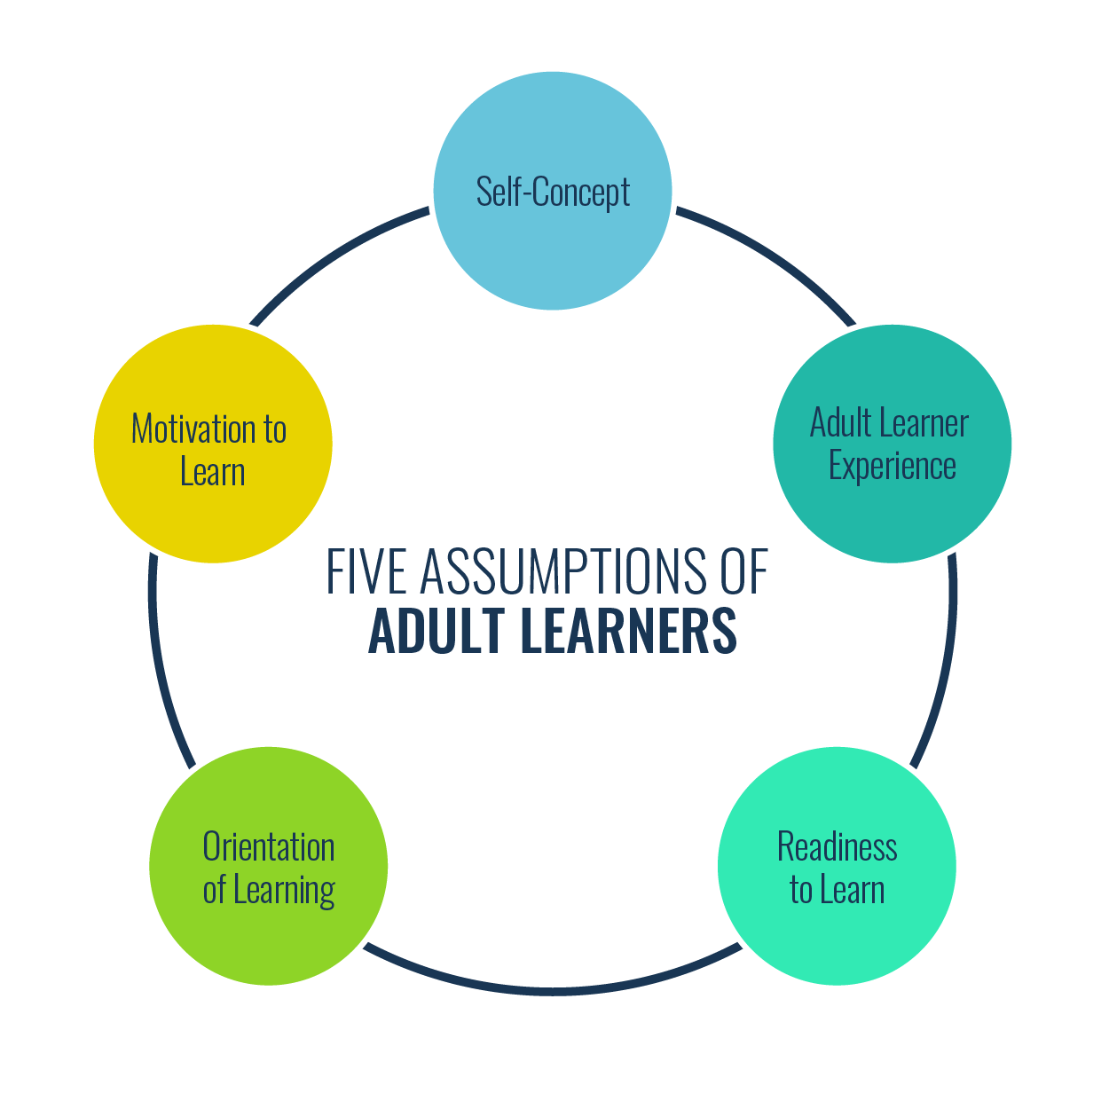
Debriefing: the real meaning of the simulation
Self-concept: adults move from being dependent on others to self-directed as they mature
Experience: as adults grow, they gain experience which becomes a valuable learning tool
Readiness to learn: adults want to learn and are prepared to do so when there is a good reason
Learning Orientation: adults change their perspective on learning as they grow, moving from procrastination to immediate application and problem solving
Motivation to Learn: adults’ priorities change and they are therefore more ready to learn about their role in society
Malcolm Knowles

Slide 7
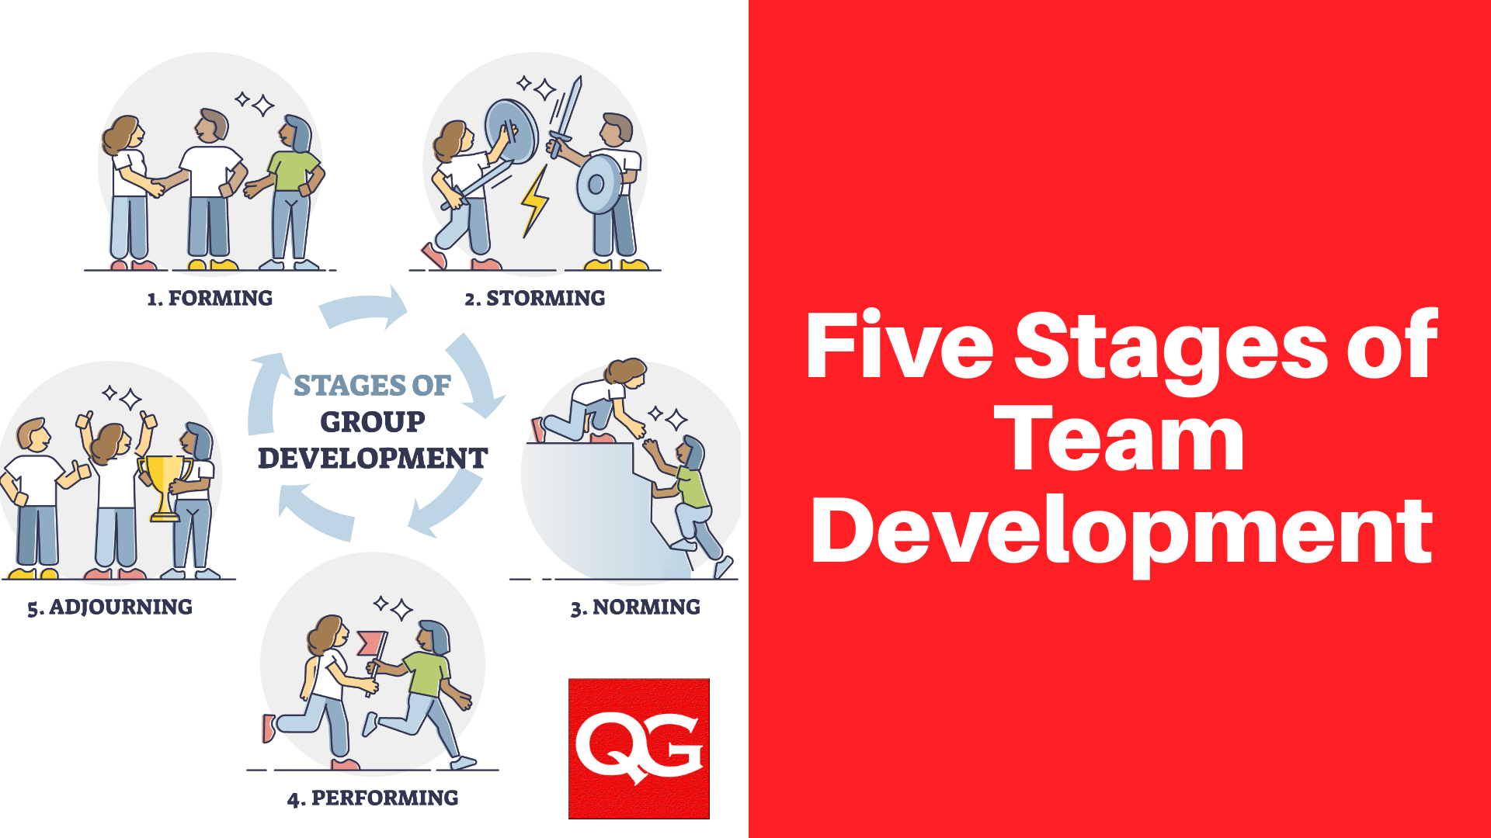
Tuckman’s model
Adjourning
The team conducts an assessment of the year and implements a plan for transitioning roles and recognizing members’ contributions.
Performing
The team works in an open and trusting atmosphere where flexibility is the key and hierarchy is of little importance.
Norming
People feel part of the team and realize that they can achieve work if they accept other viewpoints.
Storming
Members start to communicate their feelings but still view themselves as individuals rather than part of the team. They resist control by group leaders and show hostility.
Forming
Team acquaints and establishes ground rules. Formalities are preserved and members are treated as strangers.

Slide 8

Monsters and co. video
Notes:
We will give you practicat tips to avoid these situation

Slide 9
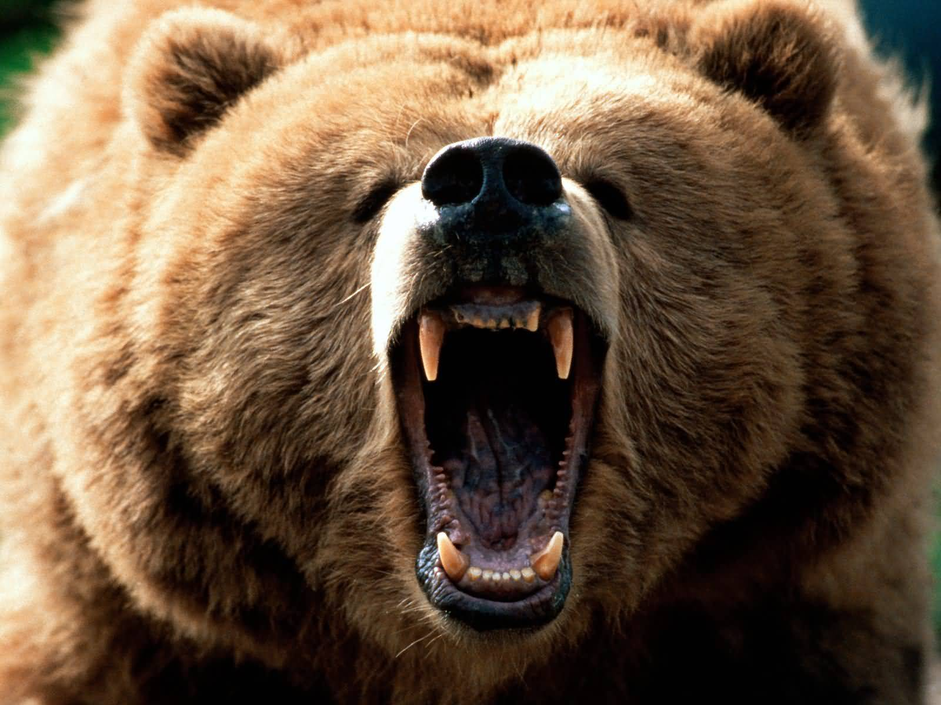
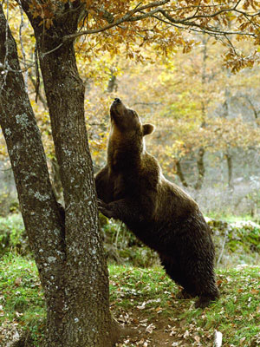
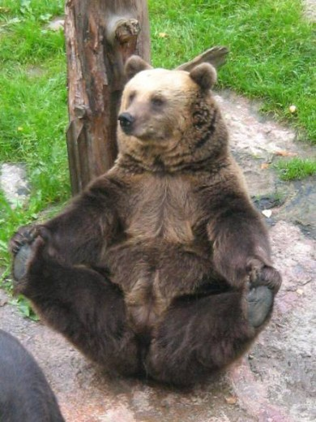
The three phases of debriefing
REACTION
KNOWLEDGE
SYNTHESIS

Slide 10
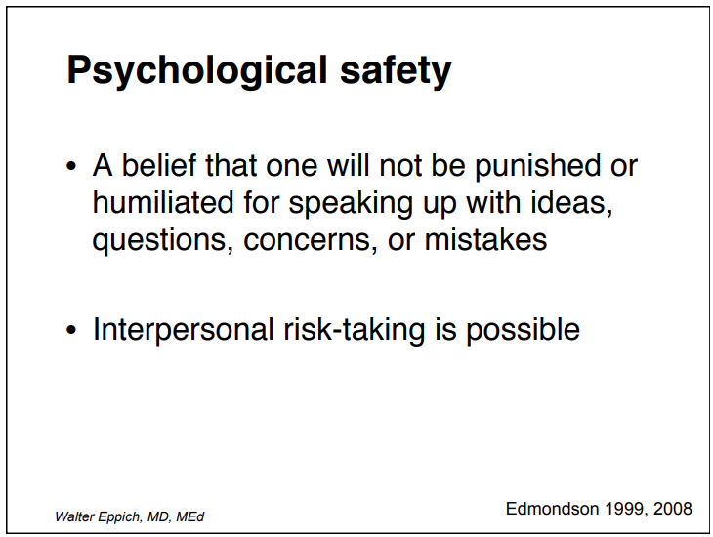
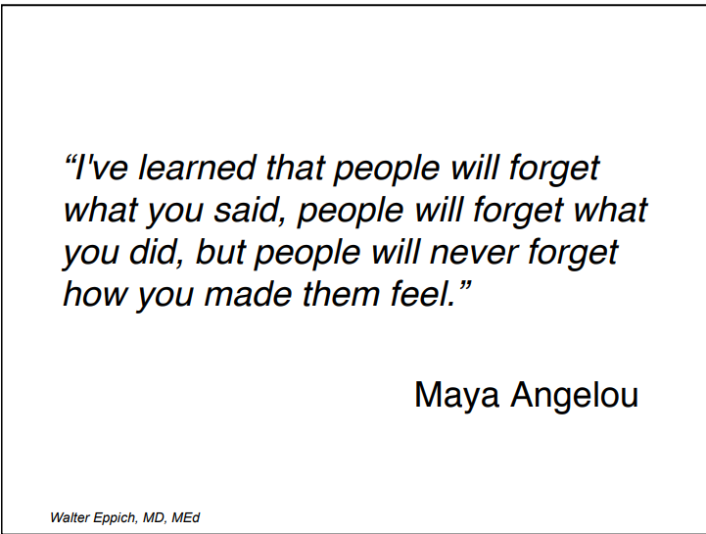
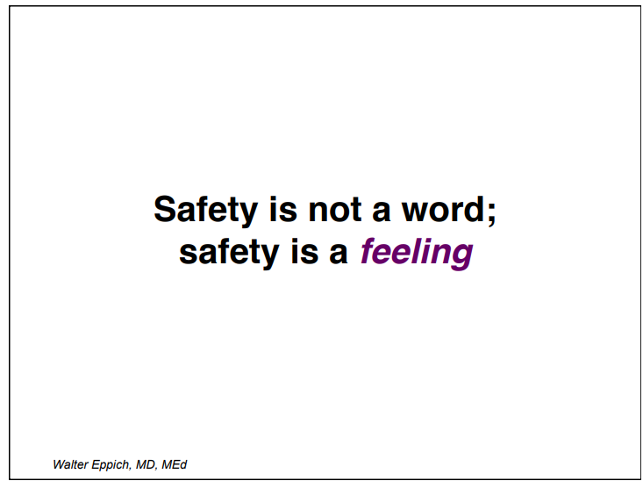
1. REACTION
“Change the scene” and set up the discussion
How do you feel?
Facts

Slide 11
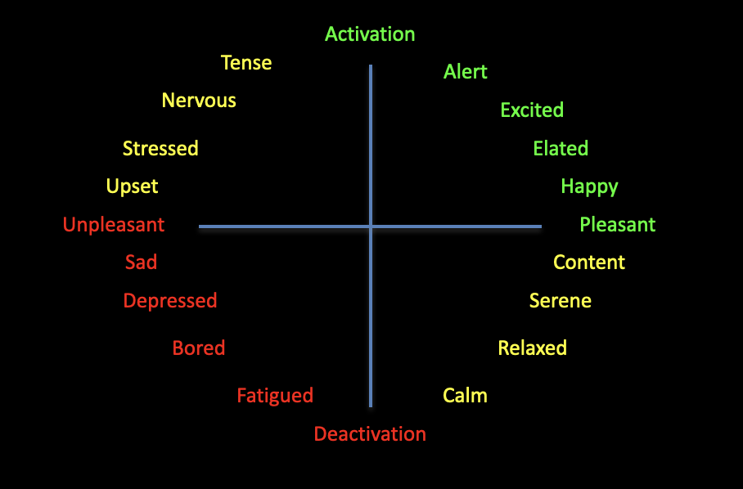
Black hole of emotions: express yourself!
Notes:
Russell and Feldman-Barret thing → interaction with audience
Helpful for the discussion?

Slide 12



2. KNOWLEDGE – Analyze and Apply
Exploring
the participant's perspective on the events of the scenario
Discussion and teaching
Help participants to navigate new perspectives, knowledge and skills
Generalyze
and apply what has been learned to real environments
WITH A PINCH OF GENUINE CURIOSITY!
Notes:
2° step – Plus & Delta Analysis

Slide 13
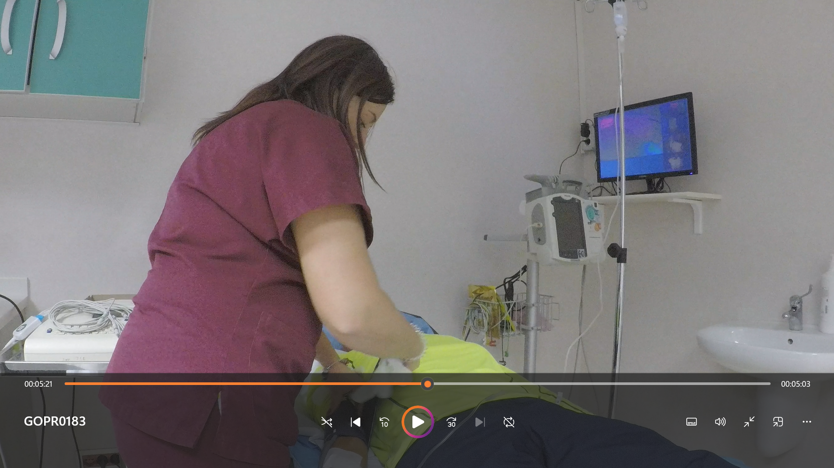
2. KNOWDLEDGE - Talk about facts (not people)
Go-Pro video
Notes:
1° step
Show the graph with time delays
Show the video of the simulation

Slide 14
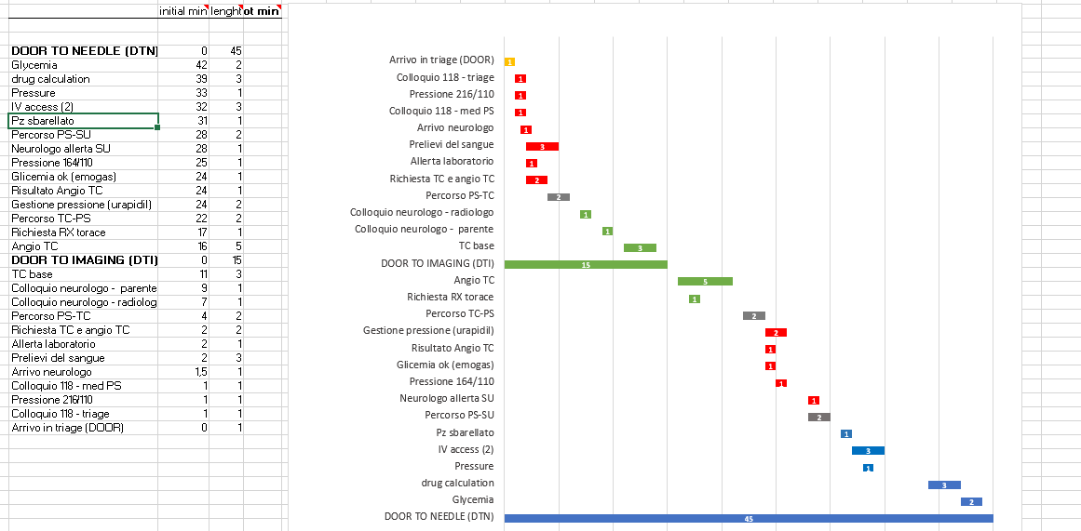
2. KNOWDLEDGE - Talk about facts (not people)
Time delays

Slide 15
2. KNOWDLEDGE – Plus & Delta
EMOTIONS
PLUS What was good? | DELTA What we need to improve?
Time onset registered at triage | Patient’s history information
Neurologist prenotification | Two IV accesses in ED
 | Reduce the time from CT results to treatment
 | Frequent ED nurses/doctors turn over
 | Additional dedicated CT scan in ED
Notes:
2° step – Plus & Delta

Slide 16
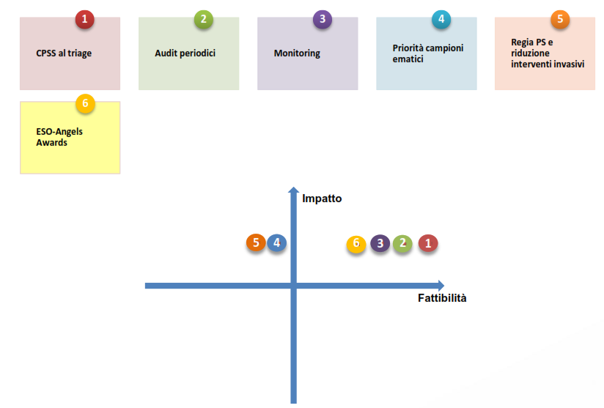
3. SYNTHESIS
IMPROVING ACTIONS
Use a checklist to collect patient history and family member telephone number | 1
Use a checklist to list the priority actions the nurse has to do in the ED | 2
Treat at CT, use the stroke bag | 3
ED training on the priority actions | 4
Additional CT scan in ED | 5

Slide 17
3. SYNTHESIS – Action Plan
WHAT | WHO | WHEN

Slide 18


It’s not just «giving feedback»… it’s having a conversation
Notes:
There are ways and ways of doing a debriefing... debriefing is often perceived as a not very important activity, The team is not motivated and when you introduce a debriefing you could have a reaction like this....

Slide 19

Notes:
https://youtu.be/59--f9WS0-4?si=llzP8FPG5SQvGOfI

Slide 20
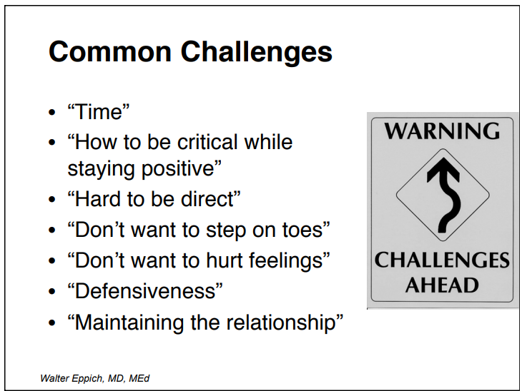
How to create a good debriefing environment
Judgemental
Non Judgemental
Good Judgemental

Slide 21
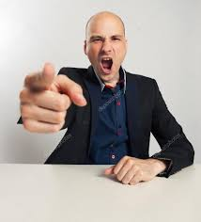
Judgemental approach
Judgemental
I have to make you do the right thing and avoid the wrong thing (according to my previous decision).
Sometimes I have to shame you... make you feel bad.
I think…
I know what went wrong… I know the answer
I must guide you on my path how to reach the goal
Use a sarcastic or shameful tone
Give the judgment and (often) the solution
Notes:
Video Monster and co

Slide 22

Non-Judgemental approach
Non Judgemental
Denying a judgment does not mean not judging
You can't blame, but... wait before you judge anyway..
Conflicting messages can undermine trust
Discordance between verbal and non-verbal communication
You can be deceptive
Notes:
Parole chiave nelle palle

Slide 23

Good Judgemental approach
Good Judgemental
To help improve or support a performance…
To share observations, opinions, judgments based on expertise
He does not presume your righteousness
Use curiosity and respect (with your own personal style) to explore the fundamentals of performance
See through the mind and perspective of the participants
Meeting the real needs of the participants, not what I think is right to address
Establish a safe context for learning and change
Strengthen our skills to deal with difficult topics
Provide information, motivation, and tools to change
REMEMBER: adults change when they make choices.
Notes:
Parole chiave nelle palle

Slide 24
Tips & Trick
Remove the “dirty” questions
It,s not just «giving feedback»…it’s having a conversation.
Walter Eppich, MD, Med
Do you think you and your team shared the defibrillator as best as you could?… what could you do?
Do you think the short time given was enough?
Haven't you thought about calling someone for help?
Why didn't you double check?
How do you think it went?

Slide 25
Tips & Trick
Generalyze
Generalize and apply the simulated experience to the participants' real clinical environment.
This method helps to anticipate participant barriers and facilitate learning.
Notes:
Examples of questions or sentences

Slide 26
Tips & Trick
Explore
Explore: Discover what invisibly drives performance
This reveals what participants really need to learn!
Notes:
Esempi

Slide 27
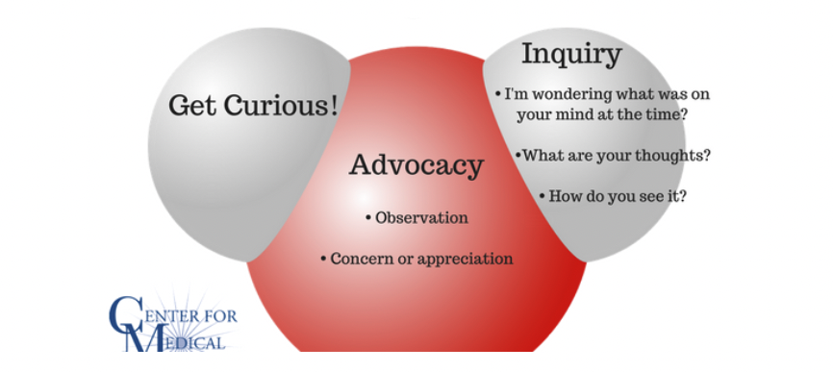

The debriefing molecole
https://harvardmedsim.org/resources/debriefing-molecule/
Notes:
Dove la mettiamo??

Slide 28
The debriefing molecole
I saw….
What are your thoughts?
I’m wondering what was on your mind at that time
I am concerned…
I really appreciated…
How do you see it?
https://harvardmedsim.org/resources/debriefing-molecule/

Slide 29
ESOC WORKSHOP - CASES
May 2024

Slide 30
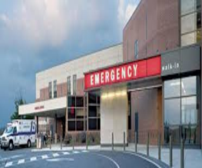
Context
Low performing, treating hospital
Has troubles with lack of personnel and high DTN
Does NOT submit data to RESQ consistently
One of the neurologists have been working in the past with Angels, and he/she is cooperative with our Consultant
The Head of Neurology - an old guy, conservatist, not willing to make big changes… He is reluctant in working with Angels and does not trust our Consultant

Slide 31
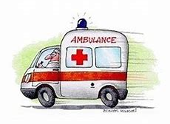

STROKE PATHWAY
ED
RADIOLOGY
ED
NO PRENOTIFICATION FROM THE EMS
ER NURSE:
VITALS
Blood samples
Blood pressure managment
Urinary catheter
NURSE:
THROMBOLYSIS:
Blood pressure evaluation
Dosage calculation
Pump setting
Drug preparation
ER NURSE:
IV Line
NEUROLOGIST:
NIHSS
Medical history
Stroke Unit Nurse alert
Ischemic stroke
NEUROLOGIST:
Clinical decision after the blood tests’ results
Thrombolysis
ER PHYSICIAN:
Neurologist alert
Analyses lab alert
Medical history
Radiological exams request
Sending patient to neuroradiology
NEURORADIOLOGIST:
Head-CT
CT-angio
0 min
45 min
70 min
90 min
100 min
160 min
First evaluation and activation of STROKE CODE
Evaluation in ED
Radiological exams
Laboratory exams results:
CLINICAL DECISION
IVT Treatment
Hospitalization in SU

Slide 32

Simulation Results from the flowchart
NO prenotification from the EMS to the hospital
NO CT room prenotification
NO IV line from ED nurse
Neurologist arrives very late in the ER
Long distances between the ED and CT scan
Waiting for blood results before clinical decision
Not treating at CT → IVT treatment in ED → DTN= 100 min
Only verbal information reported
Delay in sending the images for mechanical thrombectomy
Now it’s time for the debriefing!

Slide 33
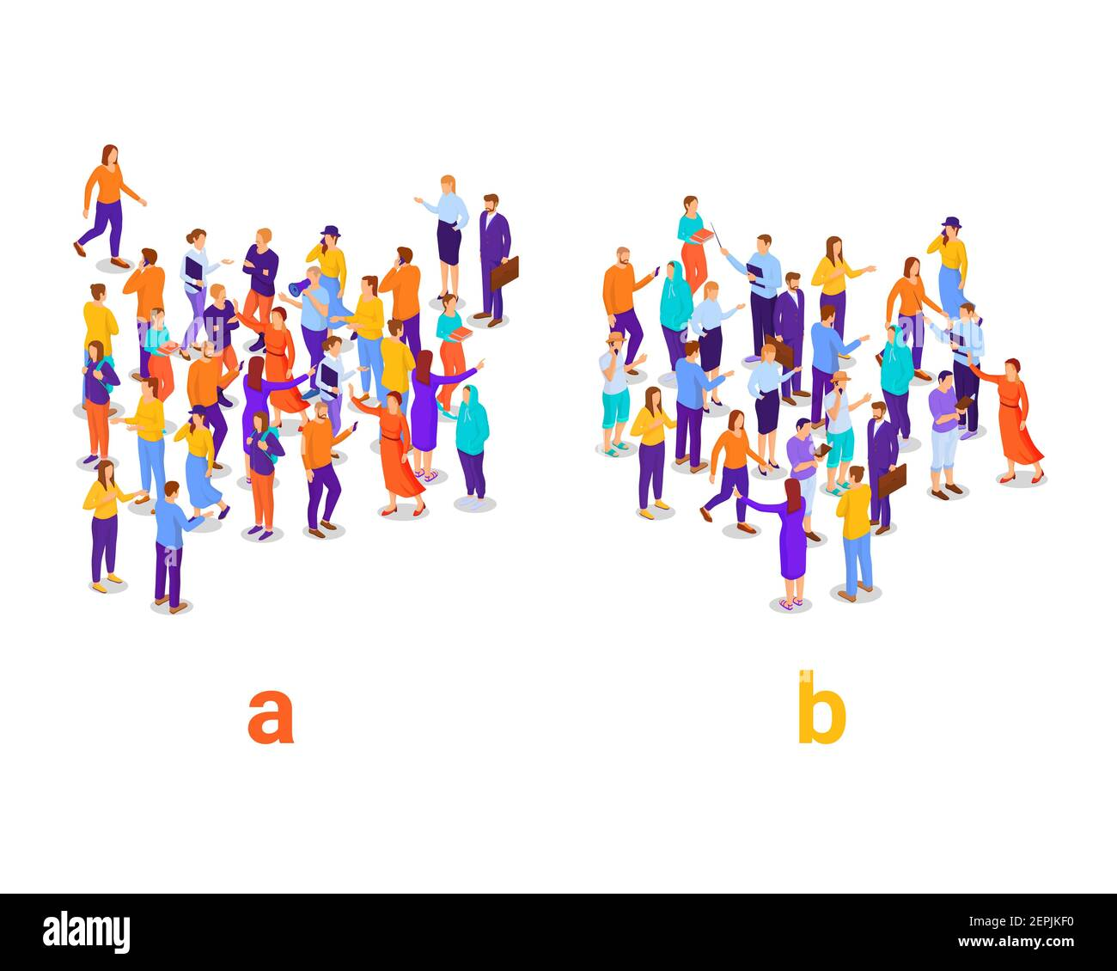
Goal of the workshop
Prepare an effective and successful debriefing session after the simulation, having good communication with the hospital staff involved.
Group A
Group B

Slide 34

HOW?
5 minutes: Group brainstorming on how you would approach the debriefing
Group A
Group B
1 Consultant
The Head of Neurology: Eleni
Neurologist: Justin
Nurse: Linda
1 Consultant
The Head of Neurology: Lucy
Neurologist: Alessia
Nurse: Bianca
5 minutes: Roleplay
Moderator: Elisa
Moderator: Stefania
5 minutes: Sharing of how you approached the debriefing (1 representative per group, 5 minutes each)

Slide 35


Slide 36
Tying it all together – the report, a not-so-perfect debriefing, and conclusions

Slide 37
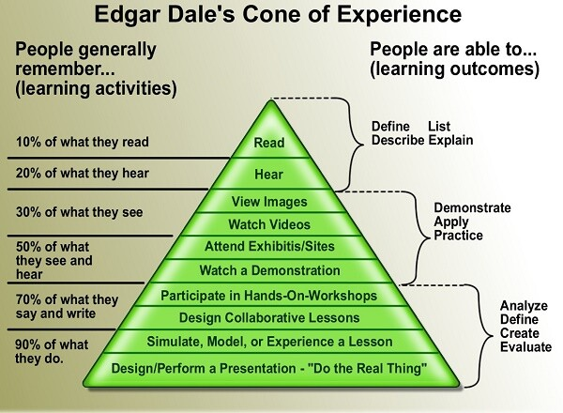
So why do we do a simulation and debriefing?
Because this!

Slide 38
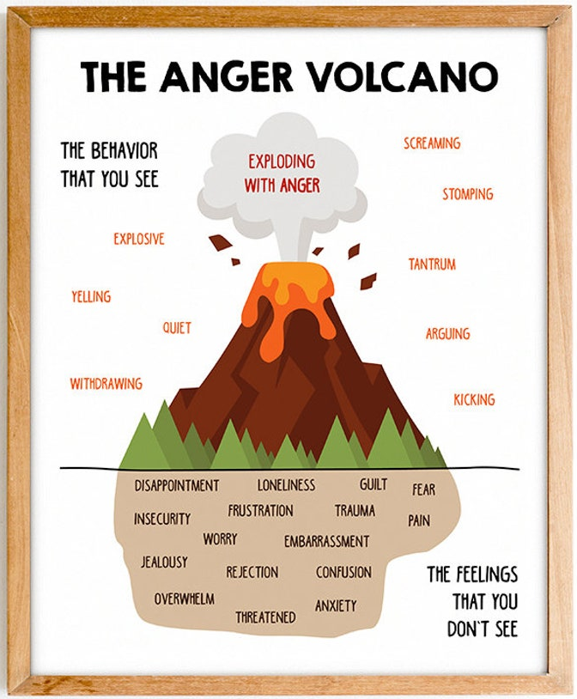
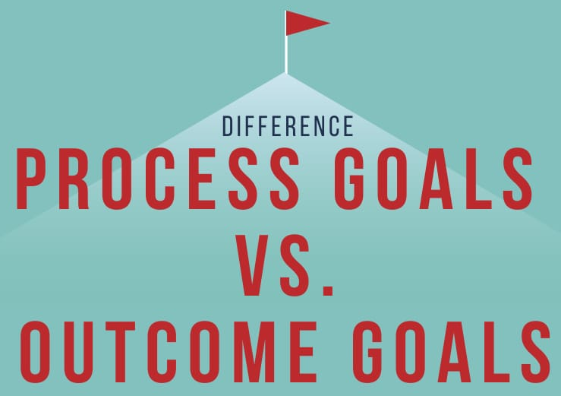
What do we need to keep in mind when doing a debriefing?
Allow for the emotions to come out first – it’s the biggest myth that people are rational beings
Stick to the facts… – what went well and opportunities for improvement
…in a non-judgmental way – no dirty questions, no finger pointing
AND ABOVE ALL
Seek to understand with genuine curiosity – from your resident Red energy person, not everything that you do has to be focused on the end result at all times, sometimes it’s better to focus on the process (who knew?!)

Slide 39
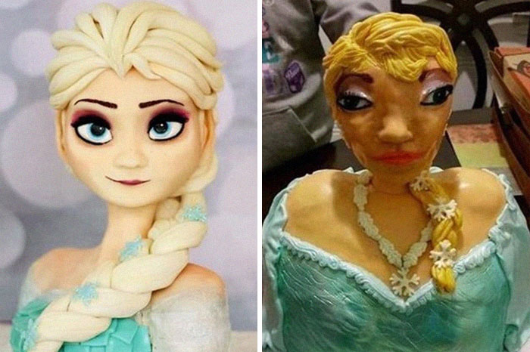
Expectations
Reality

Slide 40


Why a debriefing isn’t always perfect and what to do?
Not enough time, people must go back to work, not everyone was interested in the simulation in the first place, people weren’t properly informed
  be prepared to do an informal debriefing without presentations, charts, etc.;
  focus on the key takeaway messages that you really want to hammer home;
  in this situation a thorough report is necessary, also include the hospital director;
  repeated follow-up is crucial here to implement whatever you can bit by bit
Infighting and you’re not recognised as a figure of enough authority to be able to moderate the debriefing, people try to talk over you or see you as an enemy
  try to find your ally in the hospital team in advance, agree to co-moderate the debriefing and for them to support you;
  invite the director to be present;
  be patient, don’t contradict or interrupt them, agree with them wherever possible to make them feel heard, steer the conversation towards cooperation and producing solutions together as much as is possible for you
They ask you what church you’re from
  keep a straight face and politely explain for the 4726th time what the Angels Initiative is about

Slide 41

The report – key questions and structure
Introduction
Who is it aimed for and how well do they know you/Angels? – all doctors and nurses, heads of departments, hospital director
Exposition + Data
What information do you want to convey? – description of what you observed, hard data, strengths and weaknesses
How do you want to convey it? – before/after figures and tables, text, flowcharts, high/low priority of actions, explain the reasoning why and benefit from suggestions, include references if necessary
Conclusion
What do you want the outcome to be? – corrective measures with/without timeline, quality monitoring, how you can help, who will be doing it
Length is generally 4-6 pages

Slide 42
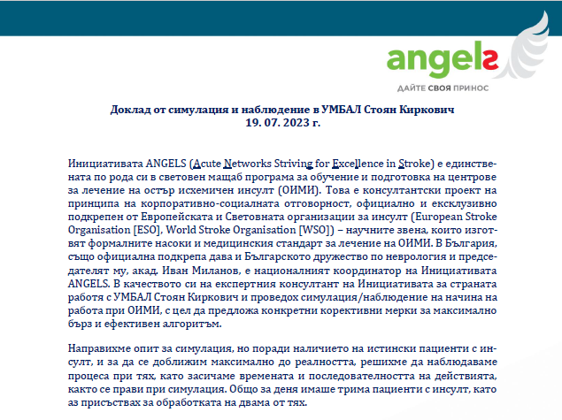
The report – Introduction
Description of Angels
Director?
Establish credibility
Highlight key partnerships
Highlight key objectives
Short summary of how event went

Slide 43

The report – Introduction
Everyone?
Short summary of how event went
Description of clinical case for their reference
Who participated
Overall impression of simulation and debriefing
Key remarks on improvement potential

Slide 44
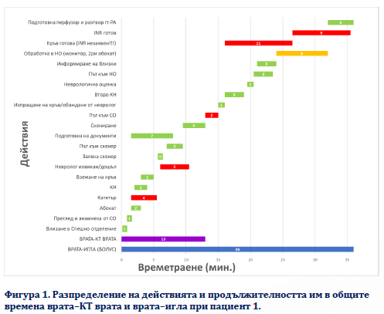
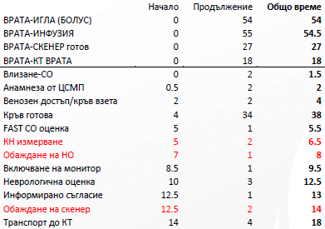
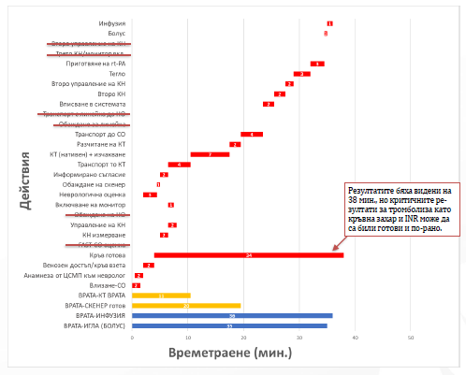
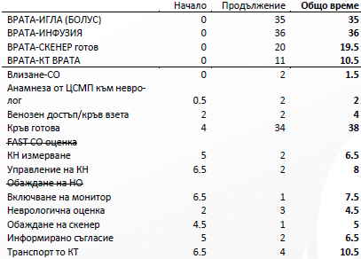

The report – exposition + data
Data table
Flow of actions with duration
Problematic actions highlighted
Include before and after version, if appropriate
And, as good scientists, don’t forget figure and table legends!
Data figure

Slide 45
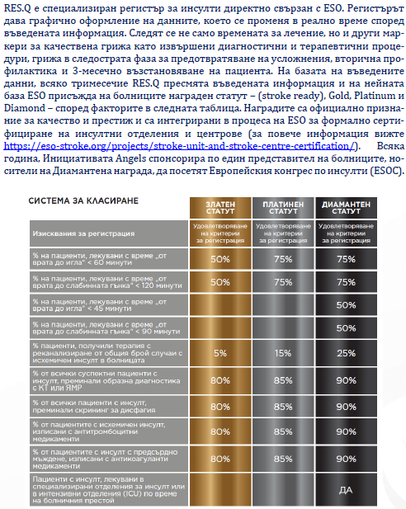
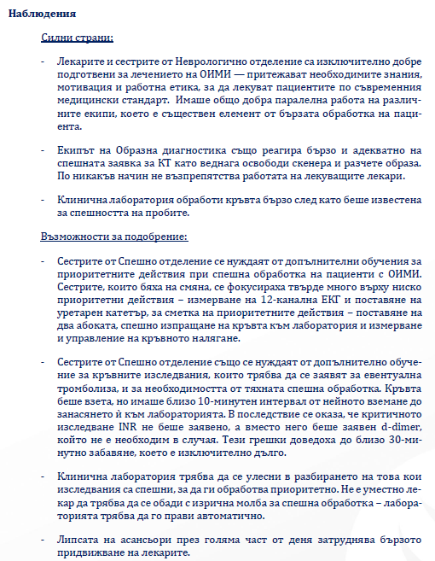
The report – exposition + data
Observations
Strengths and opportunities for improvement
With explanation of why
You can suggest trainings here
Can divide them into major and minor, if appropriate
And don’t forget the QM!
Good opportunity to explain in detail the awards and the mechanism + how it benefits them and how it feeds into the corrective actions

Slide 46
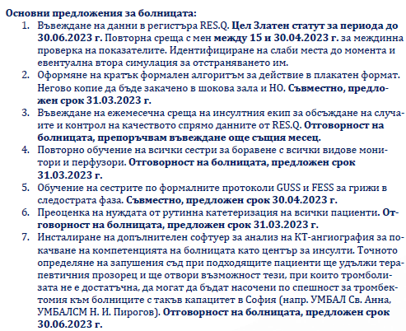
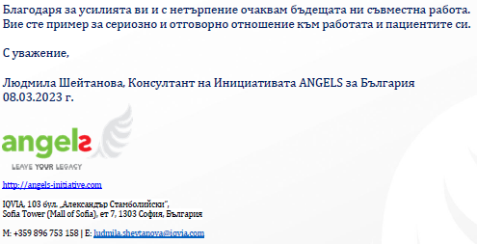
The report - conclusion
Recommendations
“Thank you for your efforts, and I am looking forward to our future collaboration. I am at your disposal for any questions and clarification. You set an example for a committed and responsible attitude towards the care of your patients.
With respect,
Your name here”
A summary of key actions to be taken
No explanation here, rationale already given
With dates and actors!
Sign off
Express intent for future work
Try to say something nice, if you can
Leave your full contact details

Slide 47


Slide 48
Thank you!

